Slide 1
06.14.2011
US Department of Energy Smart Grid Computational Tool (SGCT) Overview
Note: View presentation in Slide Show mode for best results

Slide 2
Smart Grid Computational Tool » What is the SGCT?
The SGCT is an Excel based tool for identifying and quantifying smart grid project benefits.
Characterize the Project
The SGCT characterizes smart grid (SG) projects by identifying the technology that will be installed and identifying what that technology will be do.
Identify Benefits
Based on this characterization the SGCT identifies the economic, reliability, environmental and security benefits the SG project will yield.
Guide Data Entry
Guides the user to enter data which is used to calculate the monetary value of benefits.
Prepare and Present Results
Prepares graphs and tables that summarize the costs and benefits of the project to help illustrate the project’s overall value.

Slide 3
Smart Grid Computational Tool » What is the primary purpose?
The primary purpose of the SGCT is to account for benefits delivered by a smart grid project.
Account for Project Benefits and Value (Backcasting)
What the SGCT does
Inputs are measured data and reflect actual performance
Results represent actual project value.
Translates inputs into monetary benefits and projects results forward
Analyzes a project that has been implemented and is operational
Refine metrics data collection approaches for tracking benefits
Identify the key drivers of realized benefits
Compare costs and benefits of a SG project
Quantify the benefits of the SG project or technology
What the SGCT could
be used for

Slide 4
Smart Grid Computational Tool » What is the secondary purpose?
The SGCT can also be used for estimating and forecasting the benefits of future projects.
Estimate Potential Project Benefits and Value (Forecasting)
What the SGCT does
What the SGCT could
be used for
Identify key benefits of a potential project
Analyzes a planned or hypothetical project
Develop metrics data collection approaches for tracking benefits
Utilizes key assumptions for expected project impacts and performance.
Estimates the monetary benefits that come from expected impacts
Presents an expected value of the project benefits
Support business case development for future projects
Compare the benefits of the SG project under different scenarios
Guide future investment in smart grid technology

Slide 5
Smart Grid Computational Tool » What methodology does the tool use?
The structure of the tool’s analysis is based on a series of logical questions.
MODULE 1
What are Smart Grid technologies?
What does the Smart Grid do?
How does it
do that?
What “goodness” results?
What is the goodness worth?
Assets
Functions
Mechanisms
Benefits
Monetary Value
MODULE 2
MODULE 3
Metrics
Calculations
Forecast
What data should be tracked to capture benefits?
What equations are required to translate data into monetary value?
How can benefits be projected beyond the first 5 years?

Slide 6
Smart Grid Computational Tool » What are the inputs and outputs?
The SGCT uses a variety of data inputs and assumptions, and provides standard outputs.
Click chevrons for additional detail
Inputs
Examples
Outputs
Smart Grid Project Assets, Functions, and Mechanisms
AMI/Smart Meters, Automated Feeder and Line Switching
SGCT
Data that corresponds to Impact Metrics
Annual Generation Costs, Number of Tamper Detections
Monetary Value of up to 22 Benefits
All Output is calculated over multiple years (beyond initial 5 years of data entry)
Data derived from estimates and assumptions
Value of Service, Price of Capacity at Peak, Value of CO2
NPV Analysis of Project
Cost Parameters and Escalation Factors
Discount Rate, Total Capital Cost, Inflation Rate, Population Growth
Sensitivity Analysis of Project
Sensitivity Factors
High and Low case Value of CO2

Slide 7
Smart Grid Computational Tool » How does the tool work?
SGCT modules reflect the activities involved in assessing the value of a smart grid project.
The SGCT is composed of three modules.
Click chevrons for additional detail
1
2
3
Project Characterization
Data Entry
Value
Computation
Purpose | Determine the list of project benefits. | Filter irrelevant metrics. Guide and assist data entry. | Calculation engine. Present results.
Inputs | Assets, Functions, Mechanisms | List of Benefits | Calculation Dataset, Sensitivity Ranges
Outputs | List of Benefits | Calculation Dataset | Tabular and Graphic Presentation of Monetized Benefits.
Key Methodologies | Asset-to-Function and Function-to-Benefit Relational Models | Benefit-to-Input Relational Model | Smart Grid Benefits Calculations, Benefit Forecast Methodology

Slide 8
Smart Grid Computational Tool » What is the SGCT User Guide?
The SGCT User Guide includes explanations of the methodologies and step-by-step instructions.
The first half of the User Guide is dedicated to:
Providing context for the tool and explaining its purpose.
Explaining the general methodology for assessing the benefits of a smart grid project.
Explaining the Asset-Function-Benefit Mapping and defining each Asset, Function and Benefit.
The second half of the User Guide is dedicated to:
Explaining the general Architecture of the SGCT
Providing a step-by-step instruction manual for using the SGCT.
The Appendix of the User Guide documents and explains:
The detailed cost and benefit calculations used in the tool
Key concepts and assumptions (ex. baseline, inputs, escalation techniques, s-curve model).

Slide 9
Key Contacts
David Walls
Managing Director
77 South Bedford St., Suite 400
Burlington, MA 01803
(781) 270-8436
DWalls@navigant.com
David Feliciano
Senior Consultant
77 South Bedford St., Suite 400
Burlington, MA 01803
(781) 270-8315
David.Feliciano@navigant.com
Forrest Small
Director
77 South Bedford St., Suite 400
Burlington, MA 01803
(781) 270-8303
Forrest.Small@navigant.com

Slide 10
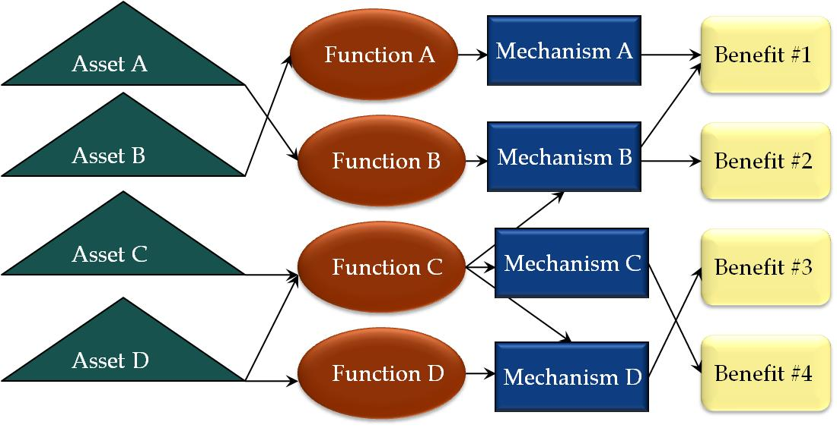
The Characterization Module helps the user navigate the Asset-Function-Mechanism-Benefit Map.
Enables Functions A, C, and D
Enables Mechanisms B, C, and D
Results in Benefit #4
USER INPUT
USER INPUT
USER INPUT
OUTPUT
BACK

Slide 11
The Data Entry Module prompts users to enter data only for relevant metrics and checks data entry.
Complete Metric Bank
Relevant Metrics for SG Project
Filters based on the project Benefits determined in the previous module
Data Quality Filter
Calculation Dataset
BACK

Slide 12
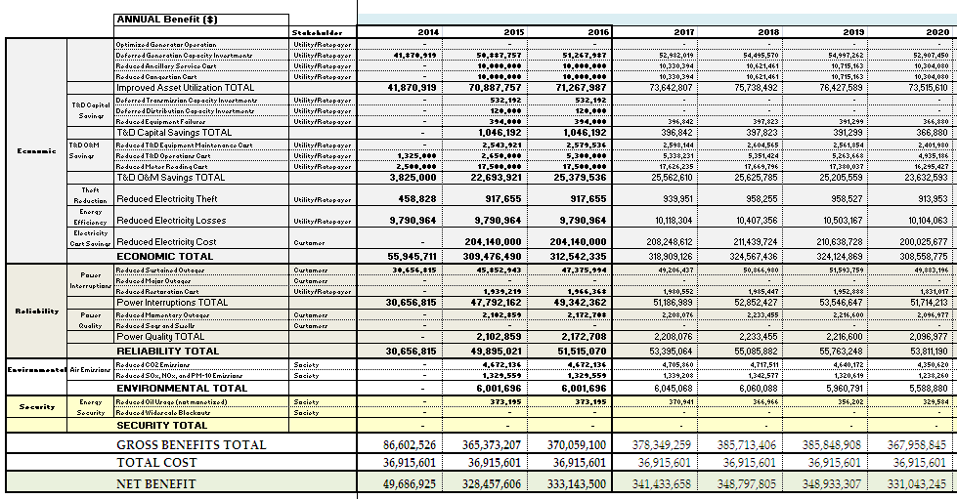
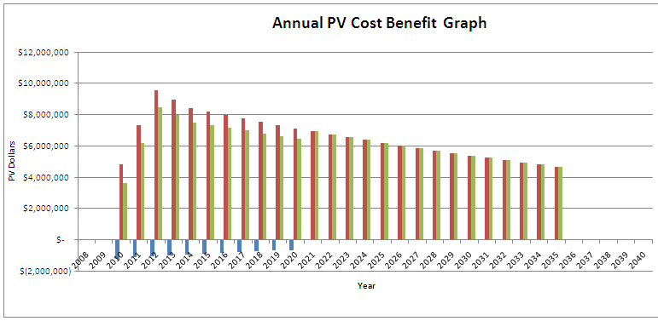
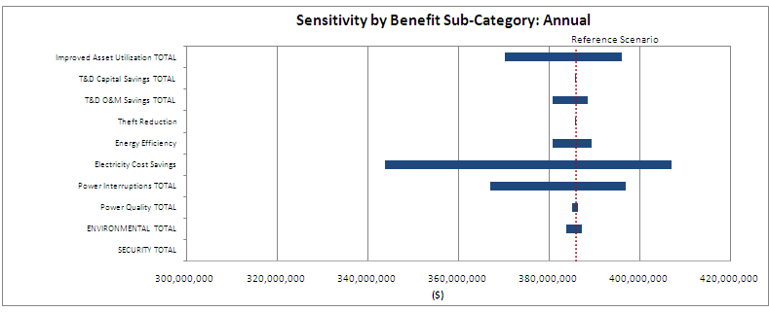
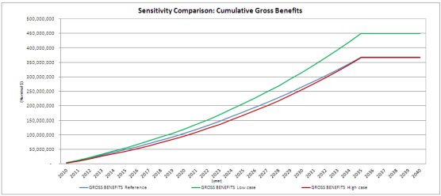
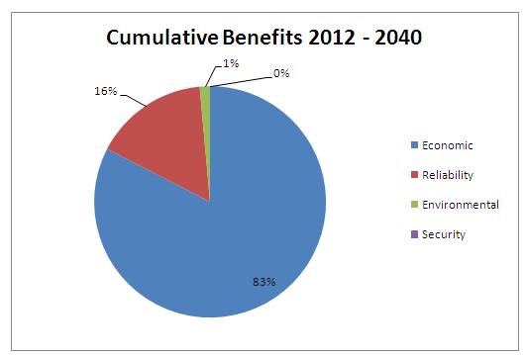
The Value Computation Module performs various performs the calculations and produces outputs.
INPUTS
Calculation Engine
OUTPUTS
22 Benefit Calculations
Calculation Dataset from previous module
NPV Analysis
High and Low Sensitivity Ranges for Inputs
Sensitivity Analysis
BACK

Slide 13
Assets, Functions, and Mechanisms define what the SG project is and what it does.
Smart Grid Project Assets, Functions, and Mechanisms
Assets – These inputs describe the SG technologies or technology groups being implemented by the project.
Functions – These inputs describe what the SG does.
Mechanisms – These inputs are linked to specific Functions and describe in greater detail how the project exercises each function.
BACK

Slide 14
Impact metrics capture the effects SG has on the electric grid or its management and operation.
Data that corresponds to Impact Metrics
Impact metrics quantitatively capture the impacts of the SG on the electricity grid or its management and operation.
This data must be directly measured or tracked after the SG project is implemented.
These metrics are used to calculate benefits.
BACK

Slide 15
Data or information that can be estimated or assumed are used in benefit calculations.
Data derived from estimates and assumptions
In addition to using data that must be directly measured or tracked, the tool uses data that can be estimated or assumed.
Examples of this type of data include: price of generation capacity at peak, the value of service to a customer during an outage, and the value of CO2.
This data is used to calculate benefits.
BACK

Slide 16
Parameters that describe the cost of the project and factors that allow results to be extrapolated.
Cost Parameters and Escalation Factors
Cost parameters describe the overall cost of the project and include items such as discount rate, interest rate, amortization period, and capital cost.
Escalation factors allow inputs to be extrapolated beyond the first 5 years of data entry so that results can be extrapolated.
Examples of escalation factors include population growth rate, inflation rate, and electricity demand rate.
BACK

Slide 17
Sensitivity Factors are used in the sensitivity analysis.
Sensitivity Factors
Sensitivity factors multiply the data inputs by a certain percentage
A high and low sensitivity factor can be set for every input in the analysis
Using these sensitivity factors high and low scenarios can be created and the results of these scenarios can be compared
BACK

Slide 18
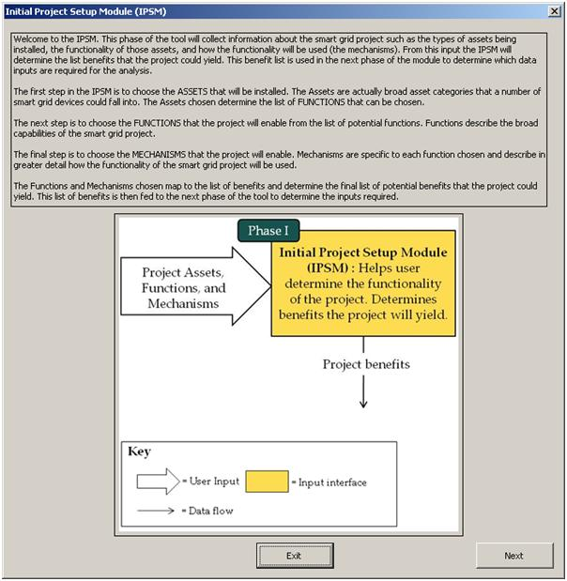
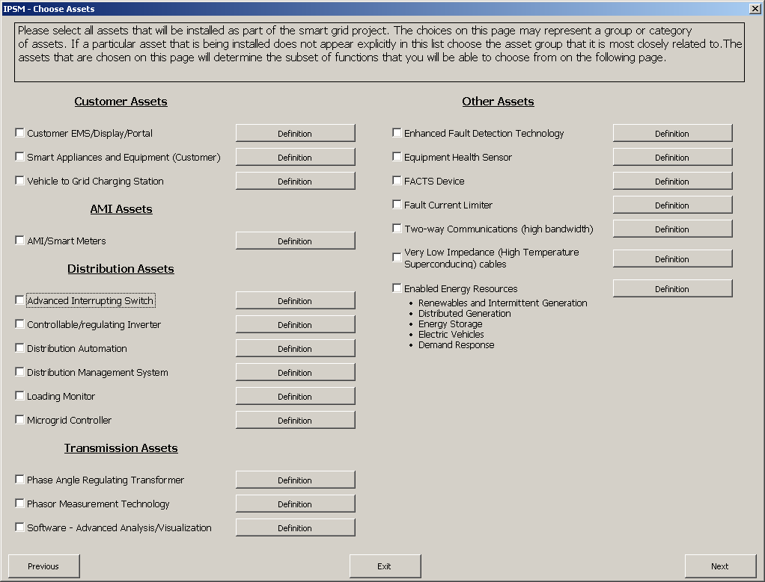
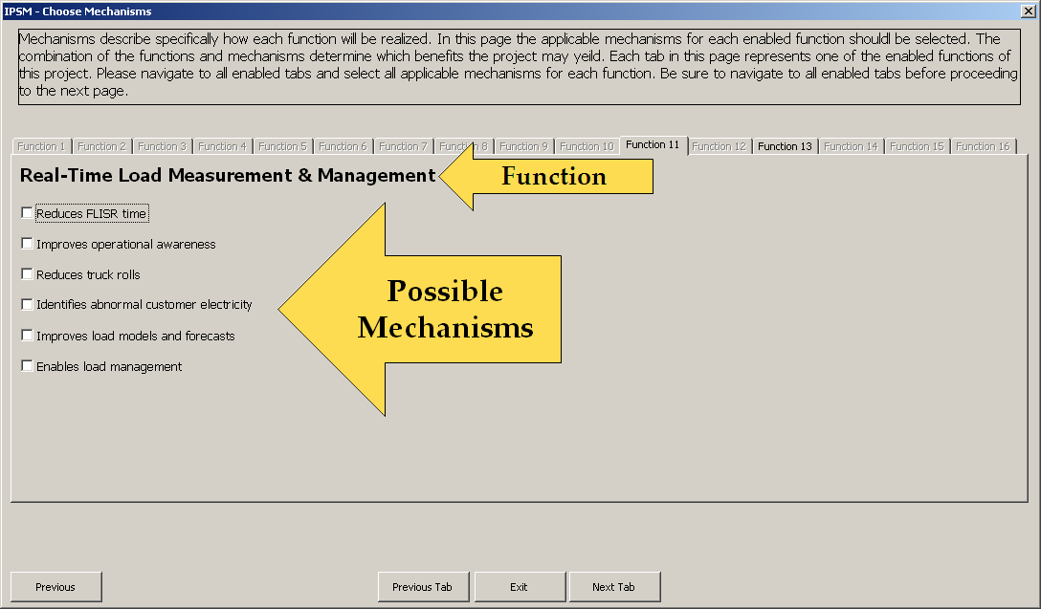
Characterization Module Screenshots

Slide 19
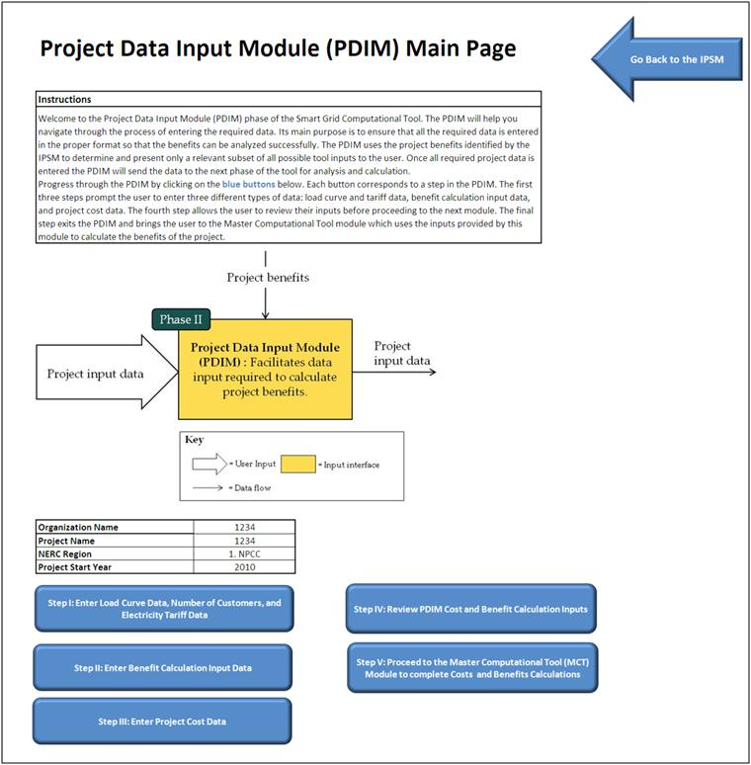
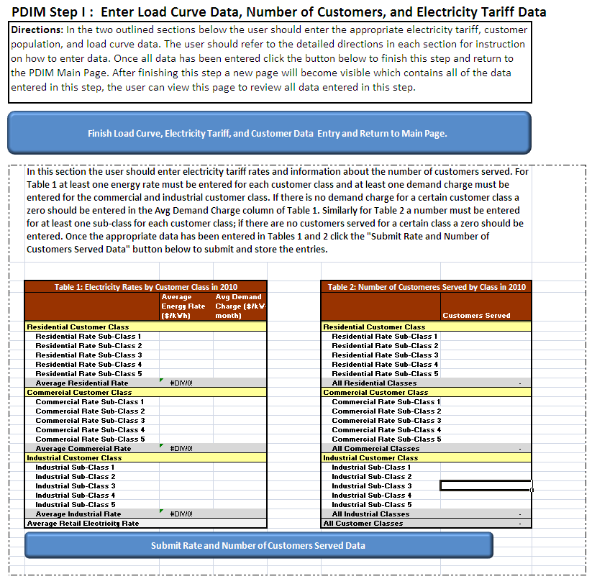
Data Entry Module Screenshots

Slide 20
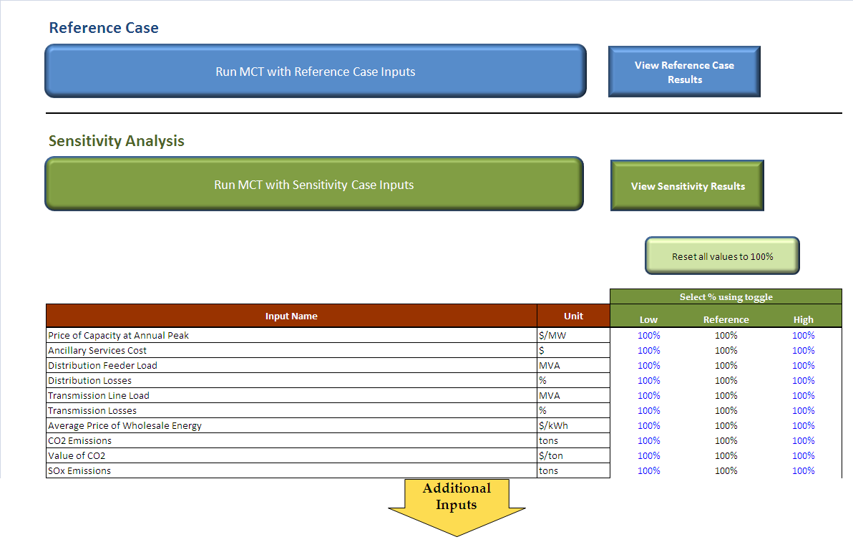
Value Computation Module Screenshots

