Slide 1
MB Hydro Experiences with Synchrophasor Implementations
Prepared by Tony Weekes
Husam Al Hadidi
Brian Archer

Slide 2
Topics of Discussion
Description of Manitoba WAMS
Introduction to Birchtree SVC Project
Commissioning Results
Lessons Learned and Future Road Map

Slide 3
Organization | PDC Contracted Connected |  | PMU Confirmed Connected Sites Devices
Ameren | 1 | 1 | 21 | 6
American Trans Co. | N/A | 1 | N/A | 5
Duke Energy | 1 | 1 | 16 | 4
Great Rivers Energy | 1 | 1 | 8 | 2
Hoosier Energy | 1 | 1 | 7 | 9
Indianapolis P&L | 1 | 1 | 6 | 7
International Trans Co. | 1 | 1 | 12 | 5
Manitoba Hydro | 2 | 1 | 22 | 6
MidAmerican Energy | 1 | 0 | 12 | 0
Minnesota Power | 1 | 1 | 4 | 1
Montana Dakota Utilities | 0 | 0 | 5 | 0
Northern Indiana Public Service | 3 | 1 | 8 | 2
Ottertail Power | 2 | 1 | 6 | 3
Vectren | 1 | 0 | 3 | 0
WAPA | 0 | 0 | 4 | 0
XCEL Energy | 0 | 0 | 11 | 0
TOTAL | 16 | 11 | 145 | 50

Slide 4
Need for wide Area Measurements
Typical PSS tuning monitors local signals
Problems can arise with fighting between controllers
Advantage of monitoring a wide area can be addressed with synchrophasors

Slide 5
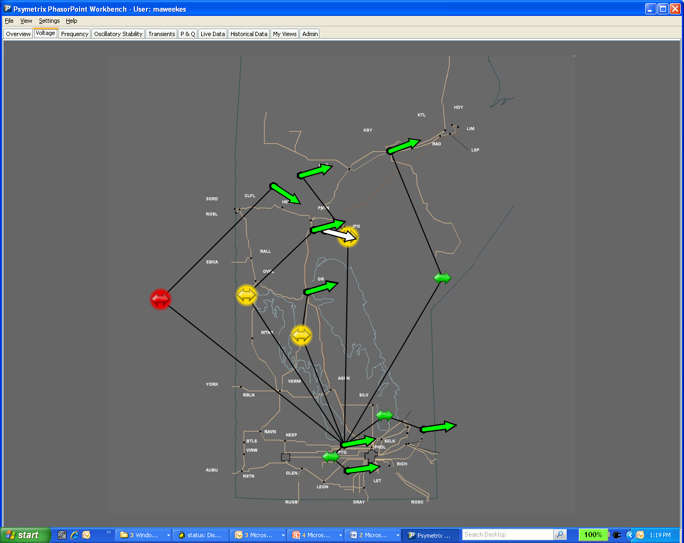
WAMS
Phasorpoint tool used primarily to see the modes on the system

Slide 6
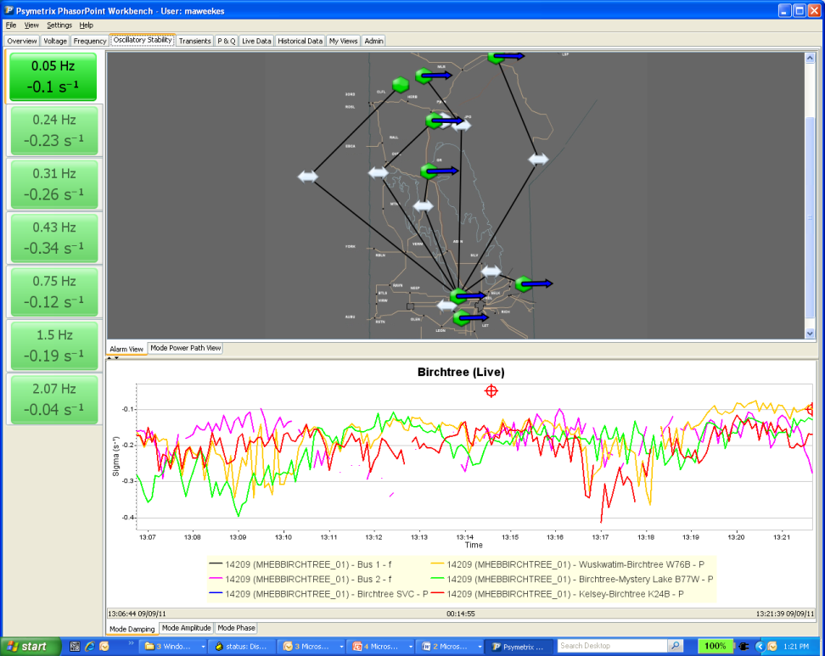
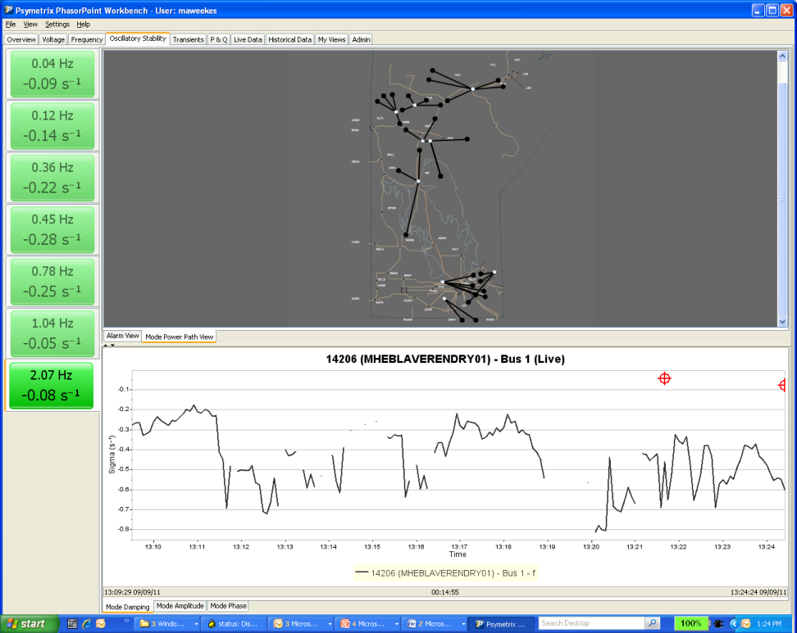
Phasor Point
Mode Charting
Mode Power Path

Slide 7
Sites Chosen
known inter-area modes in our Northern ac.
sensitivities of modes to various power flow conditions
Upcoming projects in Northern ac
Future sites will increase from 6 to 30 PMU locations
Using existing TFR devices

Slide 8
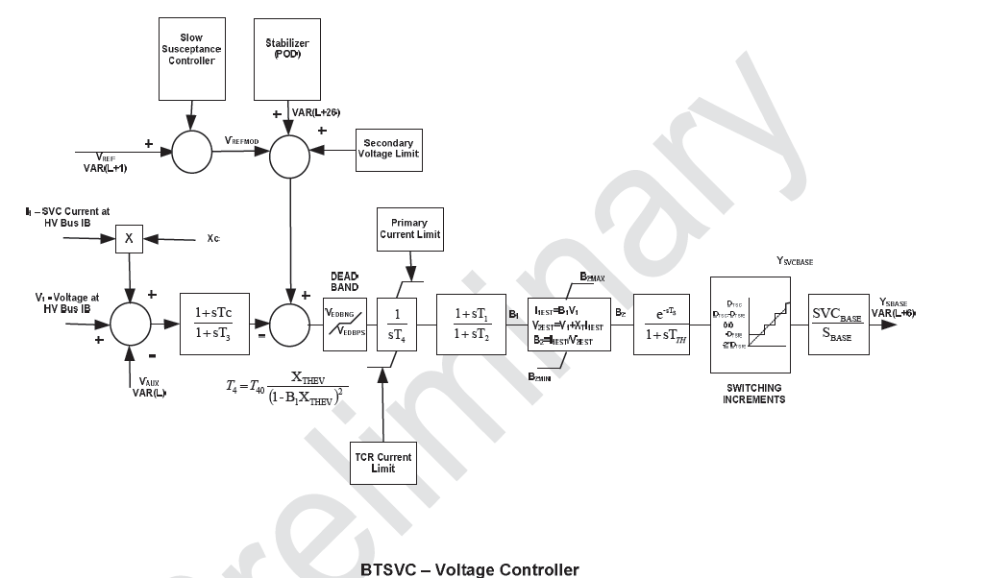
Birchtree SVC Controller

Slide 9
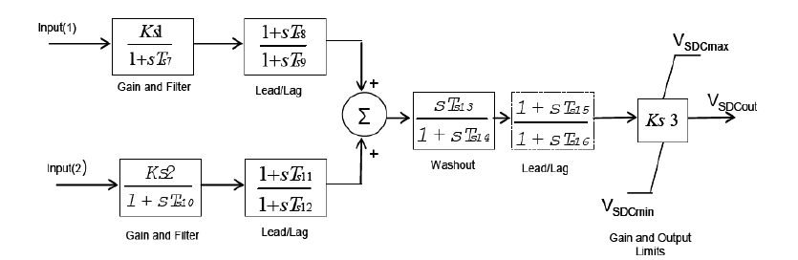
Power Oscillation Damper (POD)
Notes:
POD second input was not used but was asessed. It was designed for PMU capability.

Slide 10
Commissioning Objectives
Transfer function verification of the SVC voltage and POD controllers
Tuning the POD to provide good damping performance for the modes within the frequency range of interest 0.5 to 0.9 Hz
Minimize the interaction between the Ponton SVC and Birchtree SVC
Optimize the Birchtree SVC POD and Ponton SVC SDC settings for most northern ac system generation patterns and operating conditions

Slide 11
Risks and Mitigations
Output is correctly controlled from input, as expected
Check the degree of movement in the rest of the system in response to a step change
Confirm consistency with time-domain measurements
Decide criteria for “unacceptable” oscillations.
Switch controllers off one-by-one or plant-by-plant, separated by a period of time.

Slide 12
System Frequency Response
Model verification (frequency response) of SVC POD design
Phase
Magnitude
The frequency response characteristic (magnitude and phase) of the transfer function between Birchtree SVC input and voltage angle (frequency

Slide 13
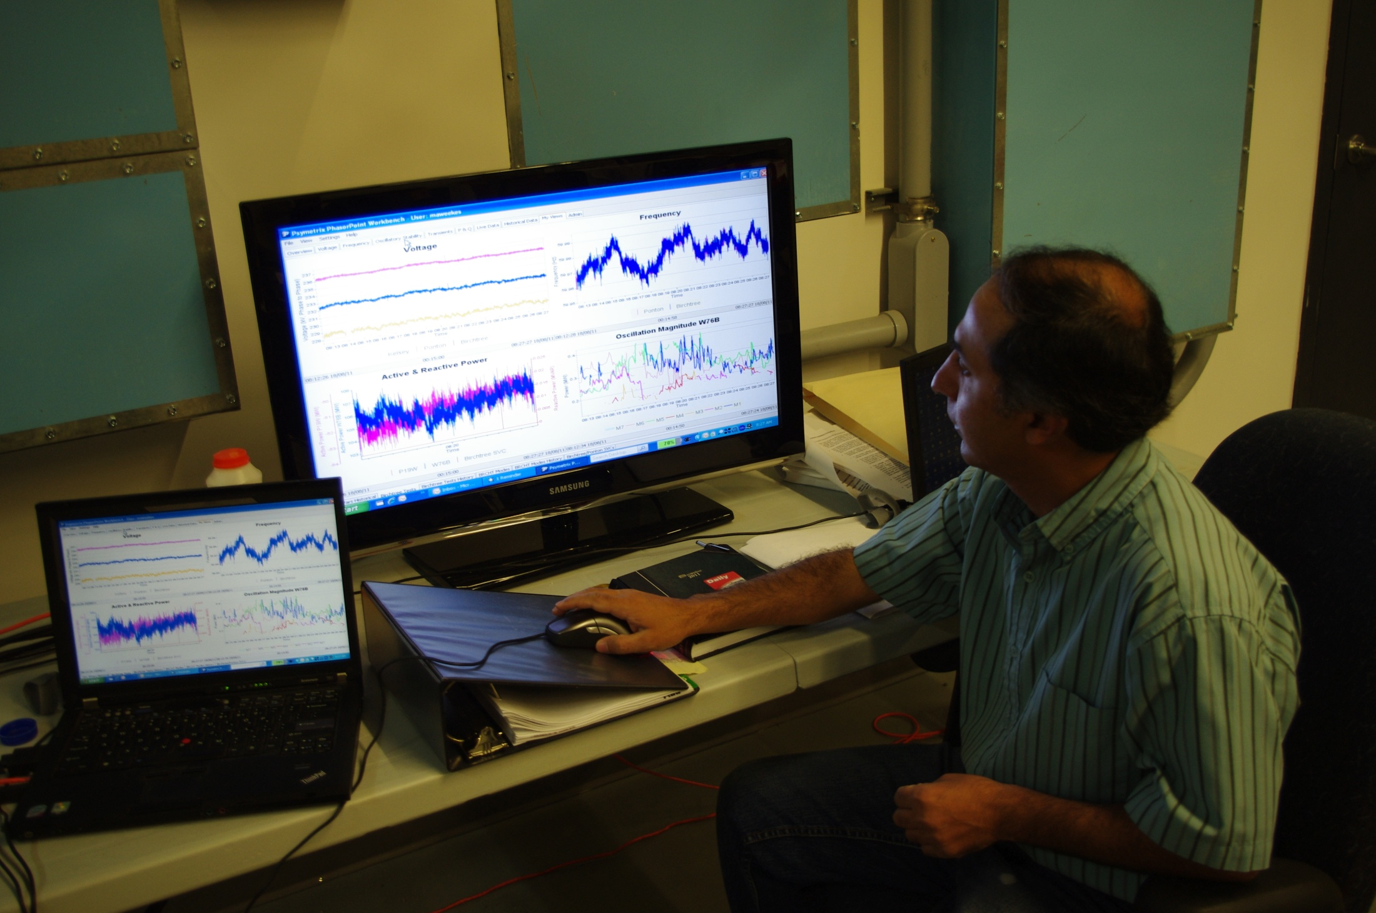
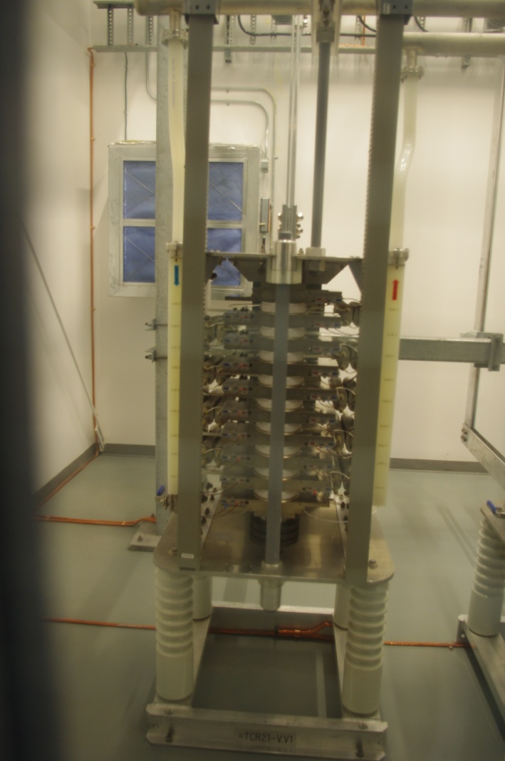
Faciltity and Phasor Point screen

Slide 14
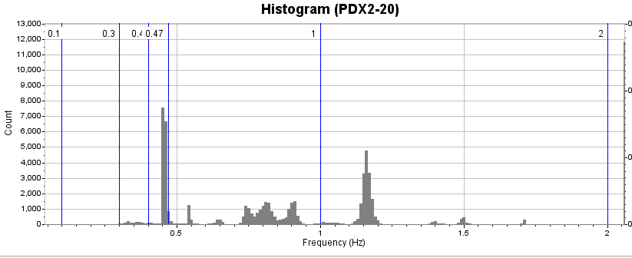
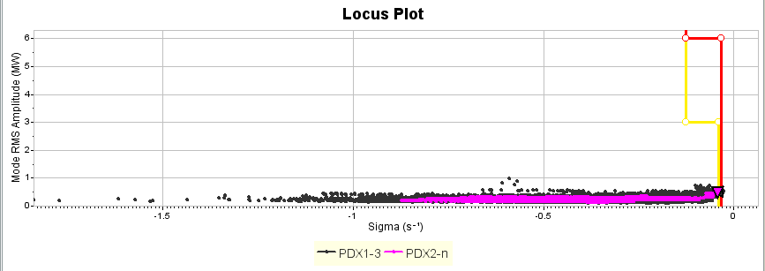
Mode Trending
Root locus of mode
Observability of the mode over time
Trending and verification of damping controller performance

Slide 15
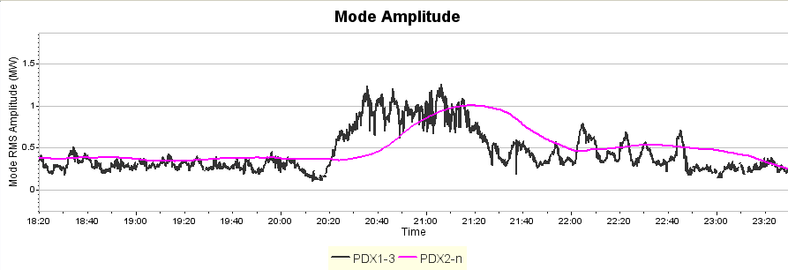
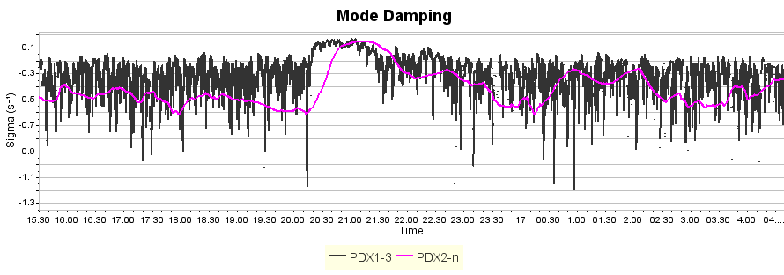
Commissioning Results
Notes:
All on intially then Kelsey OFF at 20:00, BRCHT ON only at 21:30, at 00:30 BRCTH OFF

Slide 16
Unexpected Results Captured
Mode increases with lower power
Initial response of POD with other settings
Clock error

Slide 17
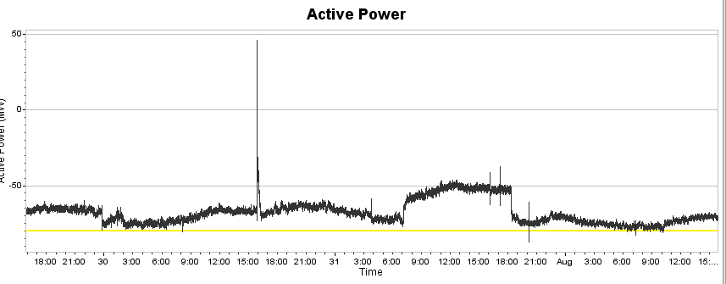
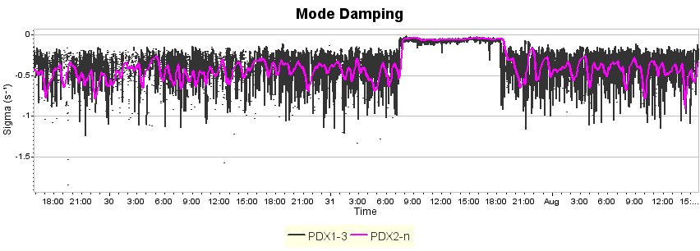
Cont…..System Baselining

Slide 18
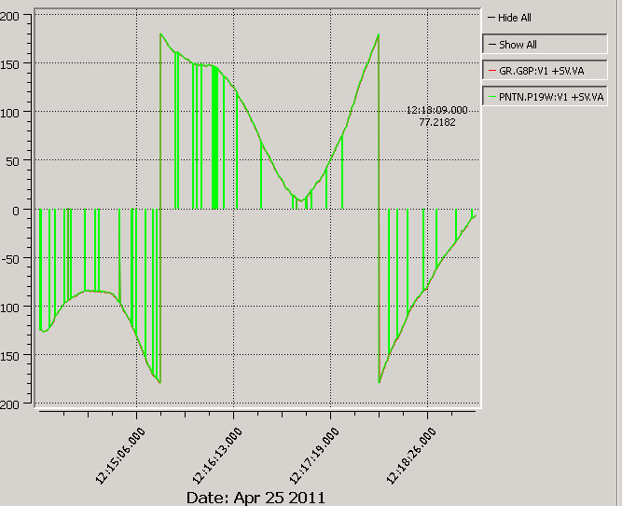
April 25, 2011 – 11:14:00 to 11:19:00 – Approx. 2 hours before event
Cont…..System Baselining
Clock Errors

Slide 19
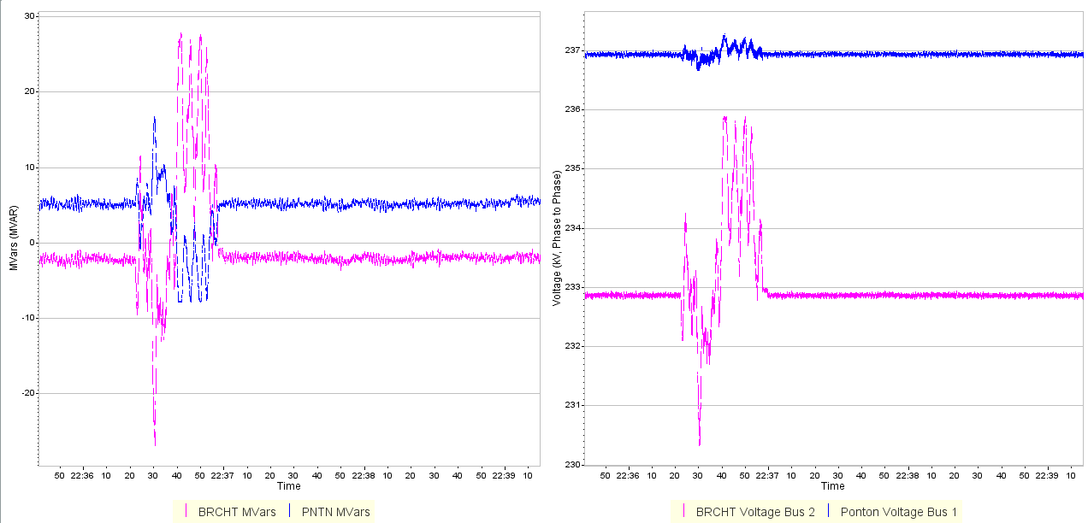
POD First Settings

Slide 20
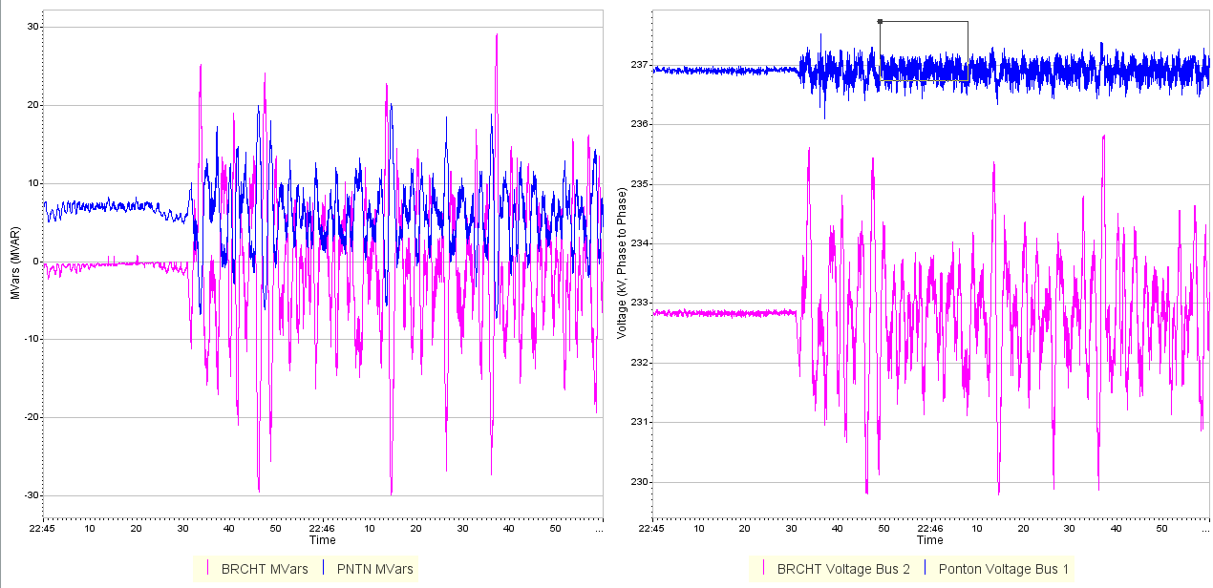
POD Second Settings

Slide 21
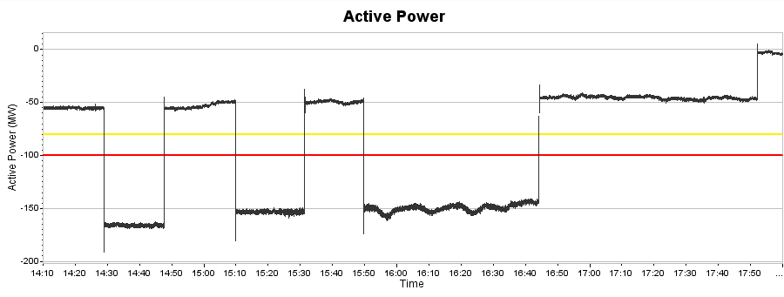
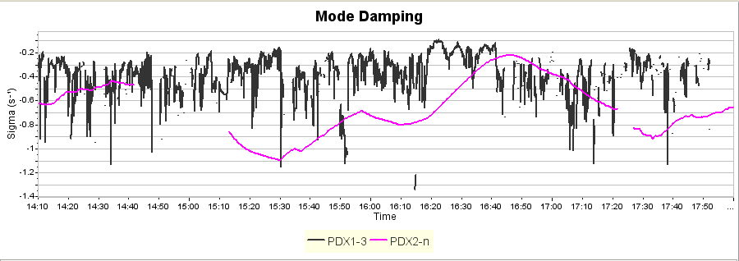
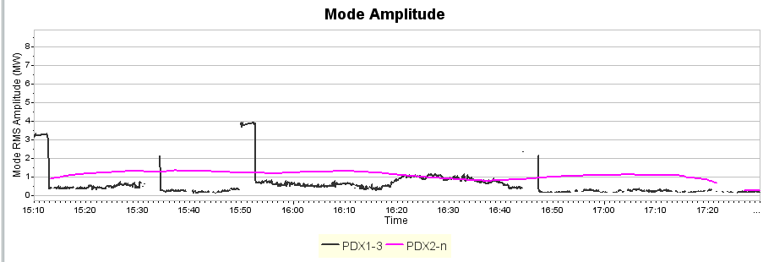
Open/Close line test
Notes:
POD on and off as well as switching of lines. 0.7 Hz mode is seen rising.

Slide 22
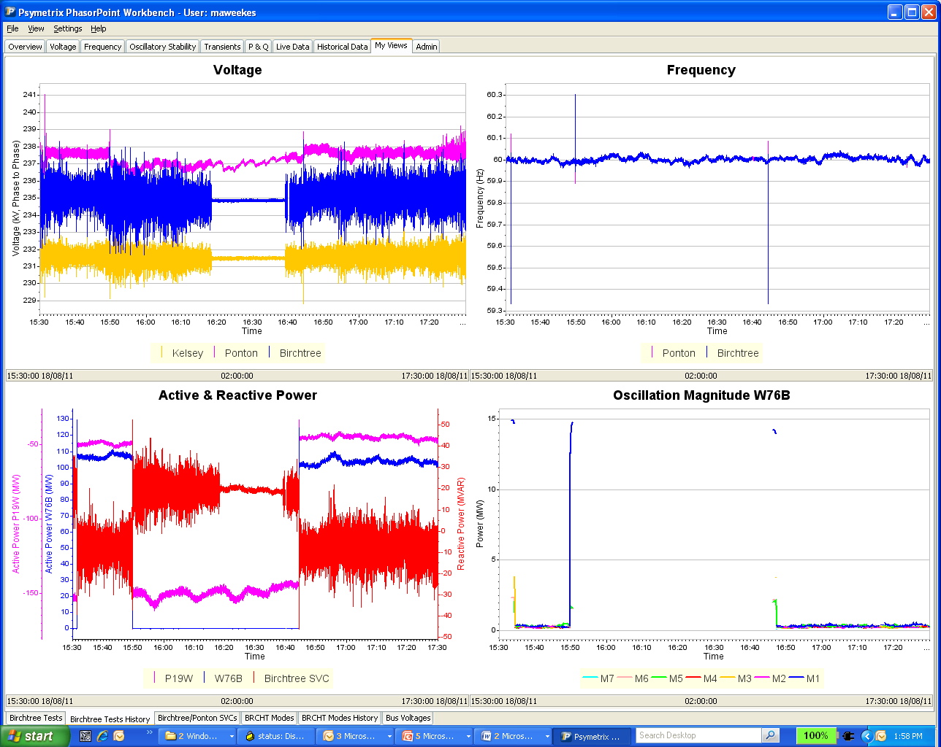
Open/Close Line Test
Notes:
One can note Mode disappear as line is opened since signal is lost – importance of choosing signals

Slide 23
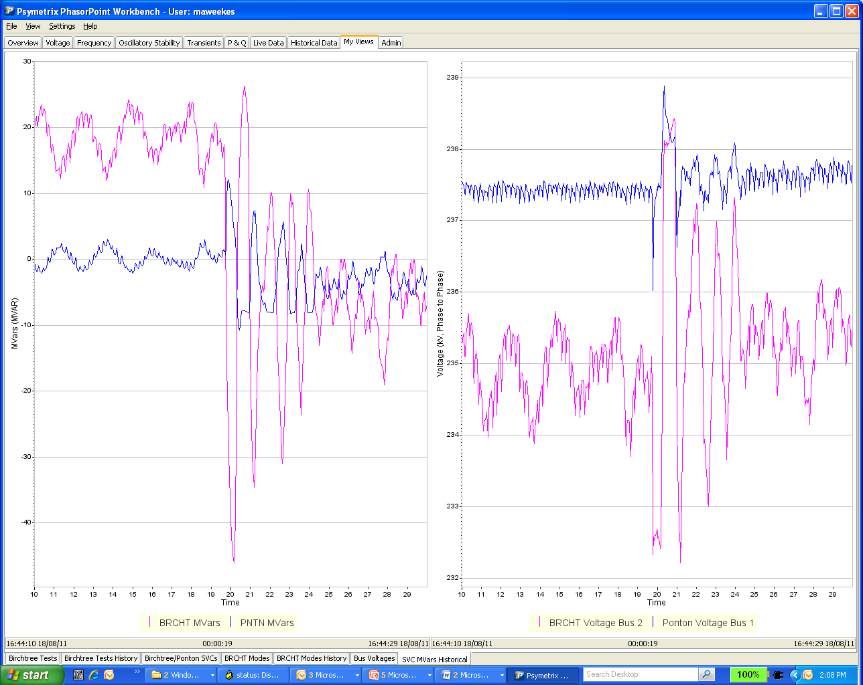
Open/Close Line Test
Notes:
Time 16:44 aug.18 ‘11 – line switching – some fighting between Ponton and BRCHT

Slide 24
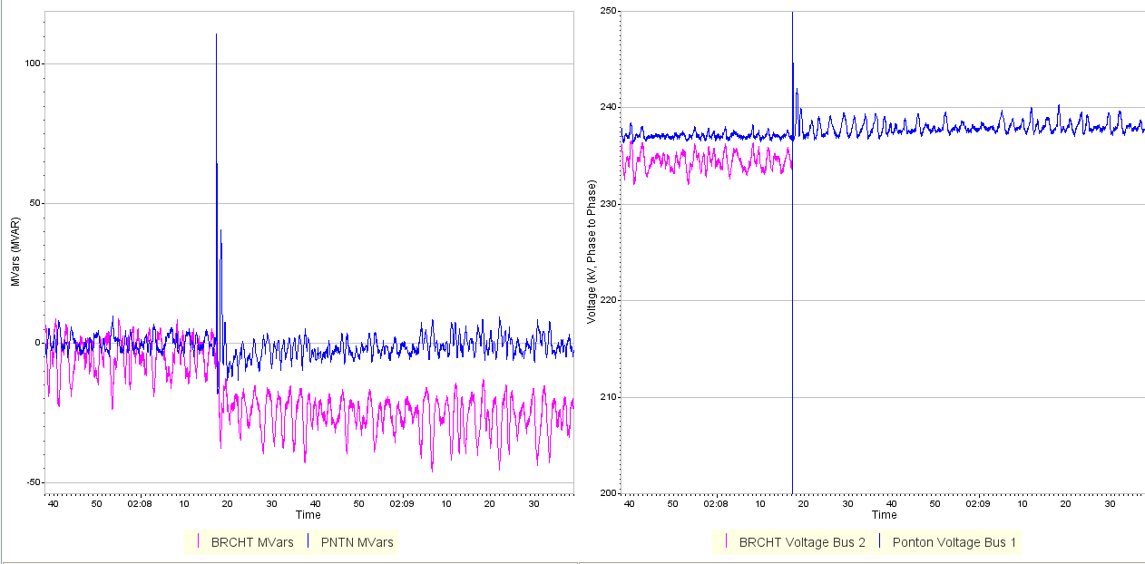
SLG Fault

Slide 25
Lessons Learned
Channel Selection (problem with power calculation if switching occurs)
Importance of doing a frequency response intially to confirm models
Real time feedback to see if and how multiple power system controllers may fight with each other.
Clock errors can be significant and need mitigation measures both in real time and regular maintenance
Integration of analog signals in the future to PMU data (also significance of proper channel selection and sites)
Unusual Modes were identified as consistently observed on the system but low in magnitude

Slide 26
Future Road Map
Model verification (complement NERC testing)
Investigations to increase transfer limits through compound event analysis
Investigation of islanding and coherency of generators
Integration with real time tools that use power models (benchmarking)
EMS state estimator improvement especially after the full complement of PMUs are on the system

Slide 27
Questions ??

Slide 28
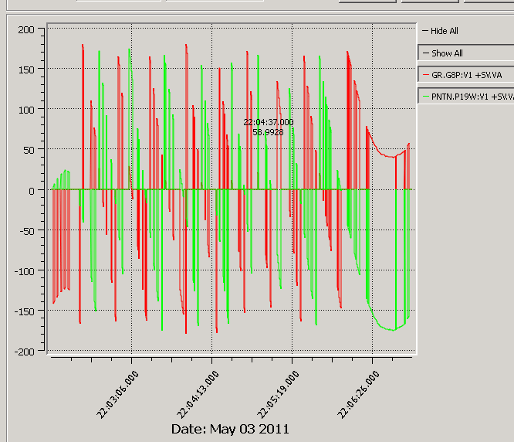
May 3, 2011
Cont…..System Baselining

Slide 29
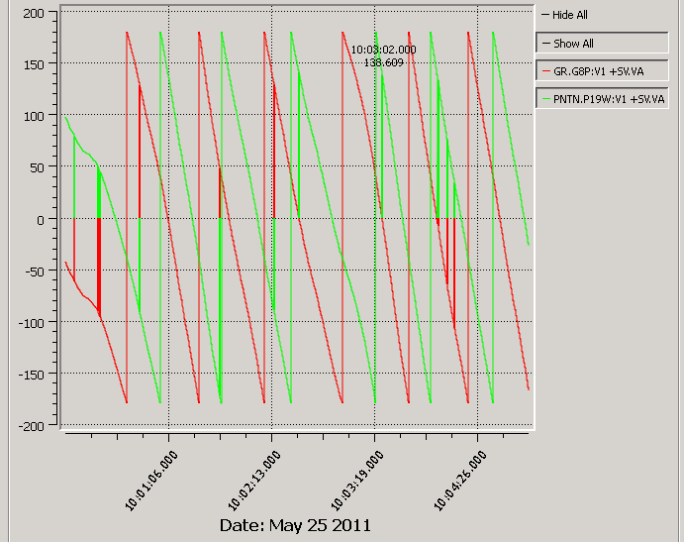
May 25, 2011
Cont…..System Baselining

Slide 30
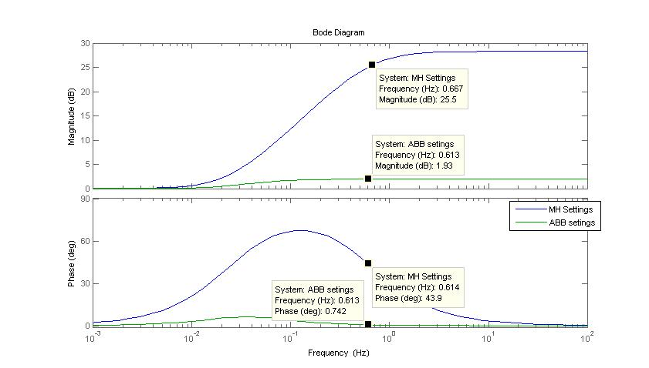
Bode Plot (Lead /lag Block)
Notes:
I must remember to remove vendor references (new slide from Husam when I return)

Slide 31
Simulation Results
Time Domain

Slide 32
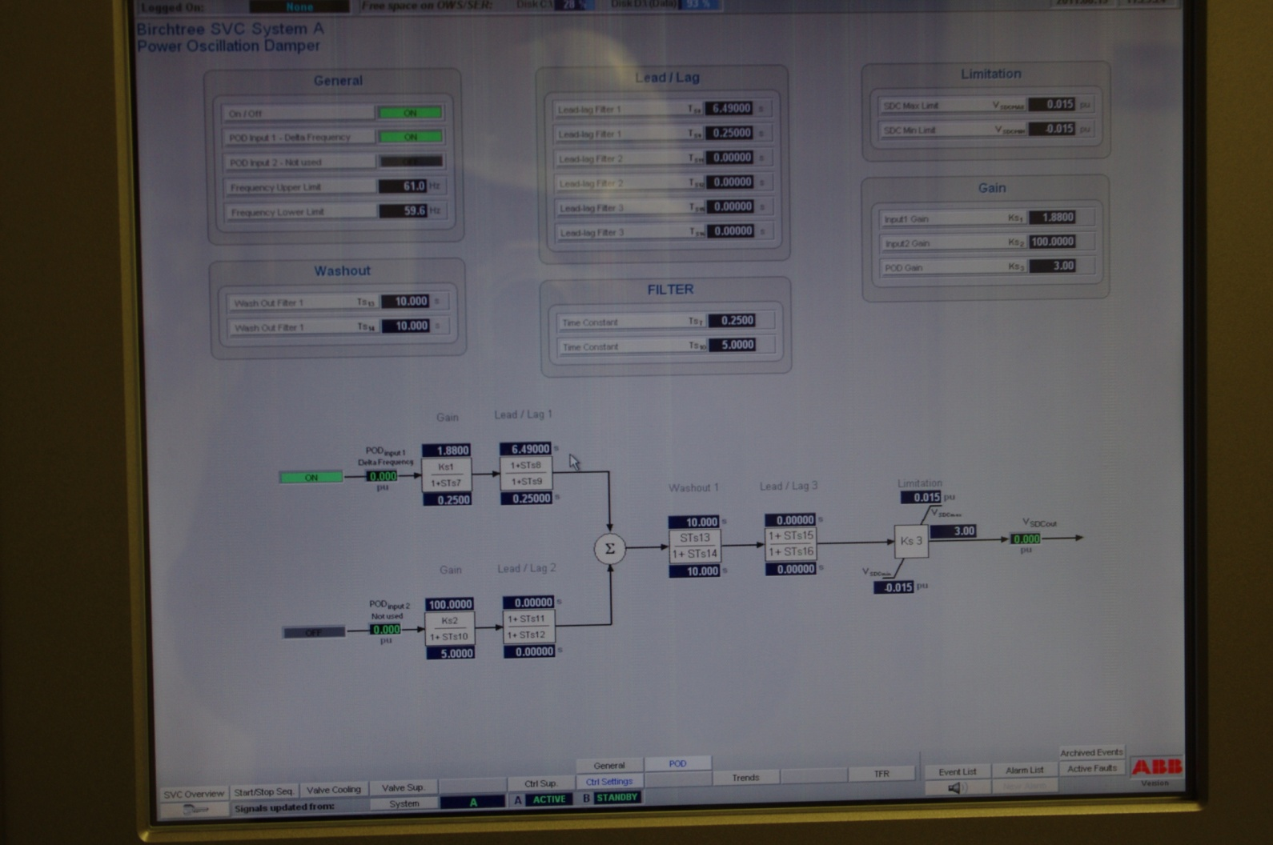

Slide 33
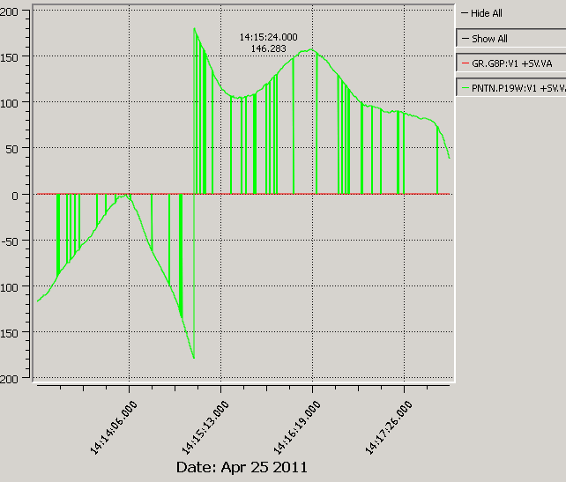
April 25, 2011 – 13:13:00 to 13:18:00 – During the time of the Event
Cont…..System Baselining

Slide 34
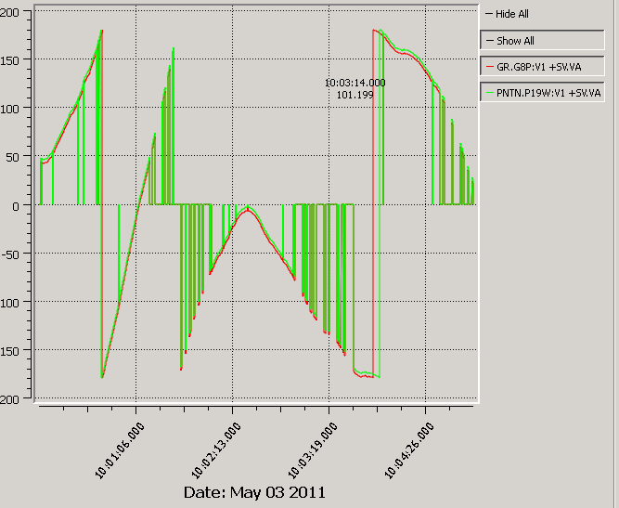
May 3, 2011 – 09:00:00 to 09:05:00 – About a week after the event
Cont…..System Baselining

Slide 35
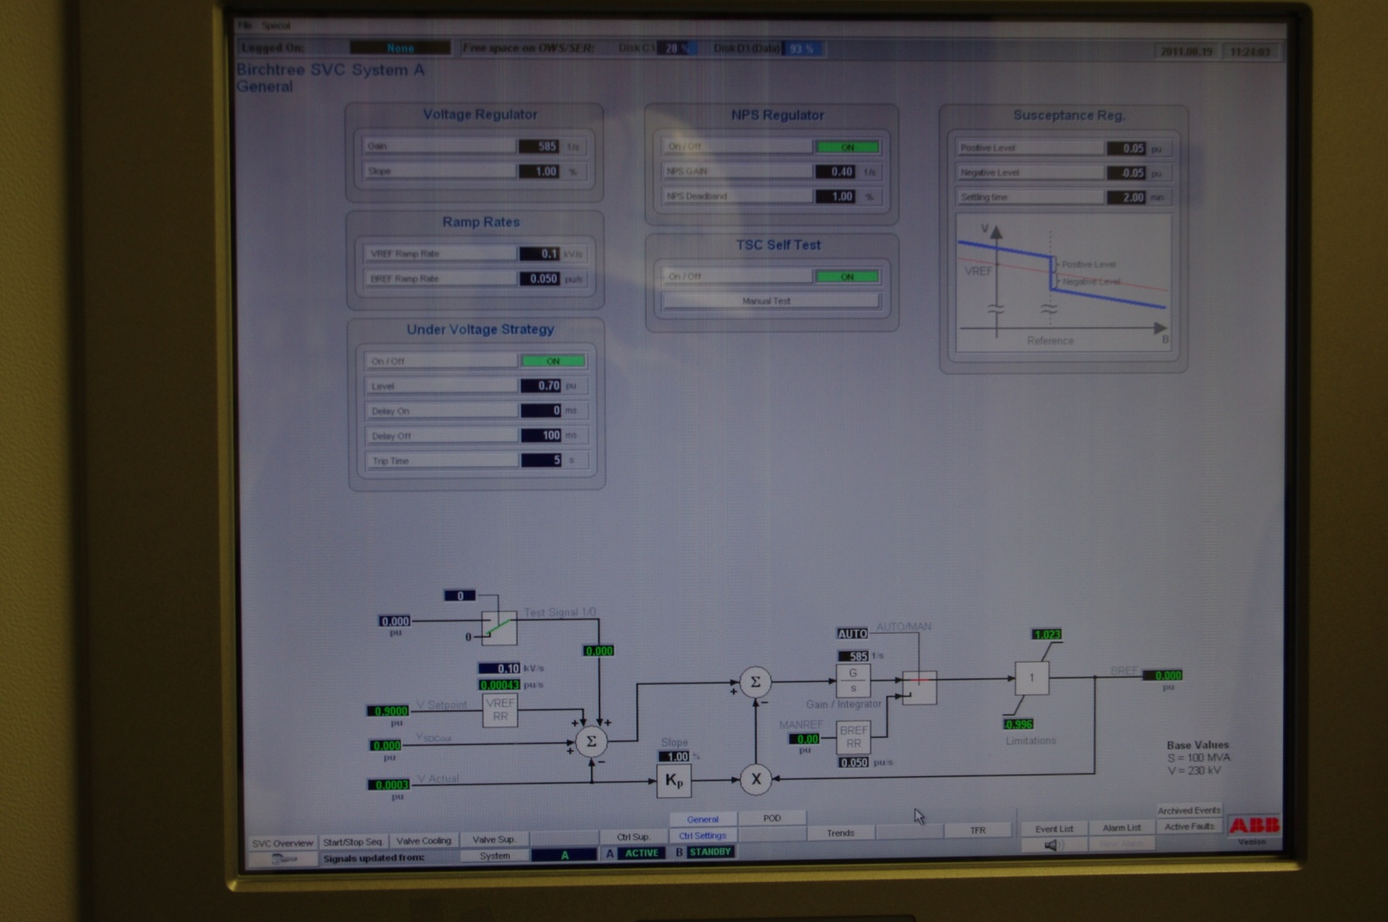

Slide 36
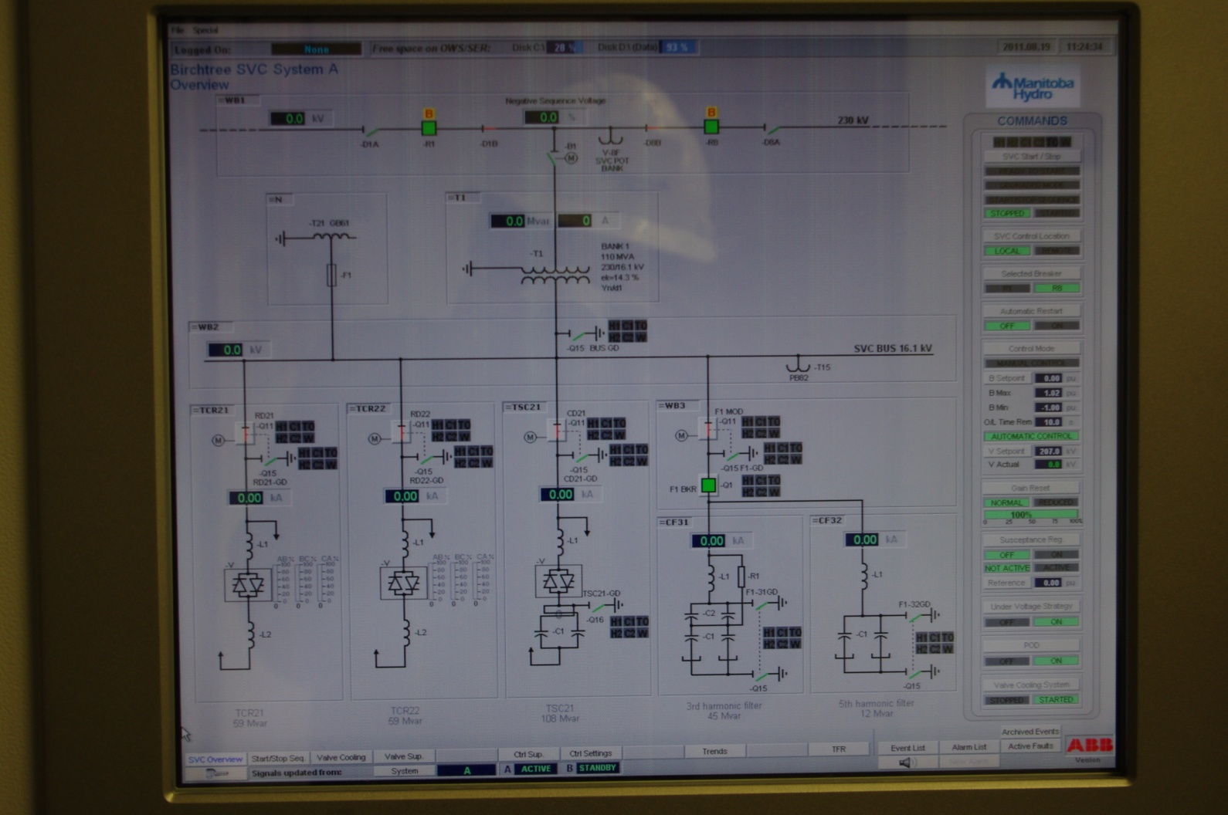

Slide 37
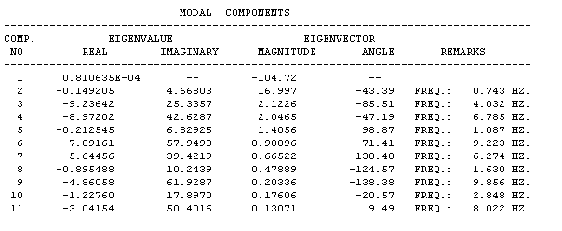
Cont….Simulation Results
Frequency Domain

Slide 38
Commissioning tests
Frequency sweep and discrete frequency injection
MW transfer change
5% Step response of genertor exciter
Open/ close line switching
SLG Fault
Notes:
POD behavior as limit is reached

Slide 39
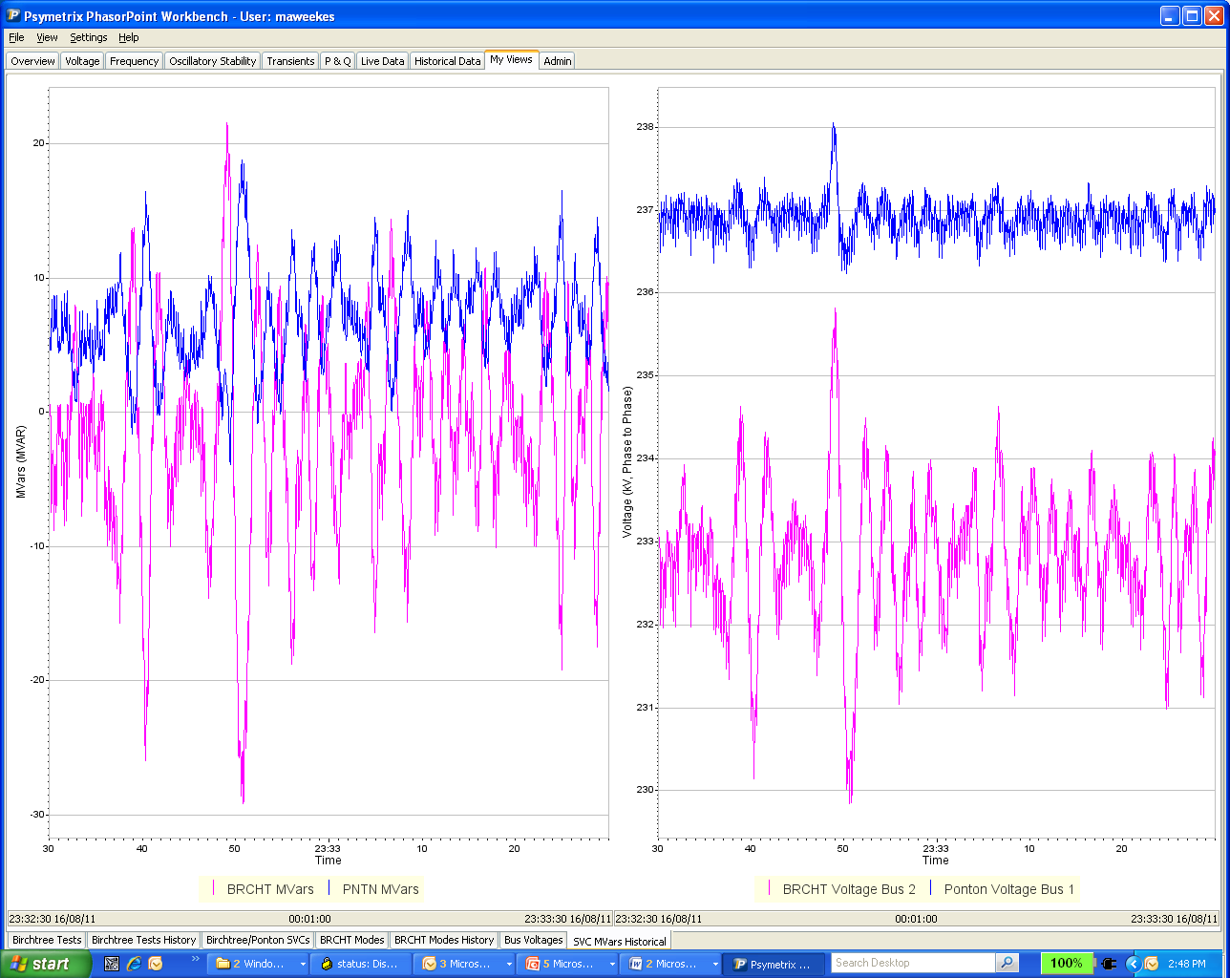
Kettle Exciter Step Change

Slide 40
Small-signal stability problems
Local plant mode oscillations: Rotor angle oscillations of single generator or single plant against the rest of the system (0.7 to 2.0 Hz).
Intermachine/Interplant mode of oscillations: Rotor angle oscillations between a few generator close to each other (0.7 to 2.0 Hz).
Interarea mode oscillations: Oscillations of groups of generators in one area swinging against a groups of generators in another area (0.1 to 0.7 Hz).
Control mode oscillations: Associated with control of equipment such as generator excitation systems (2.0 to 5.0 Hz).

Slide 41
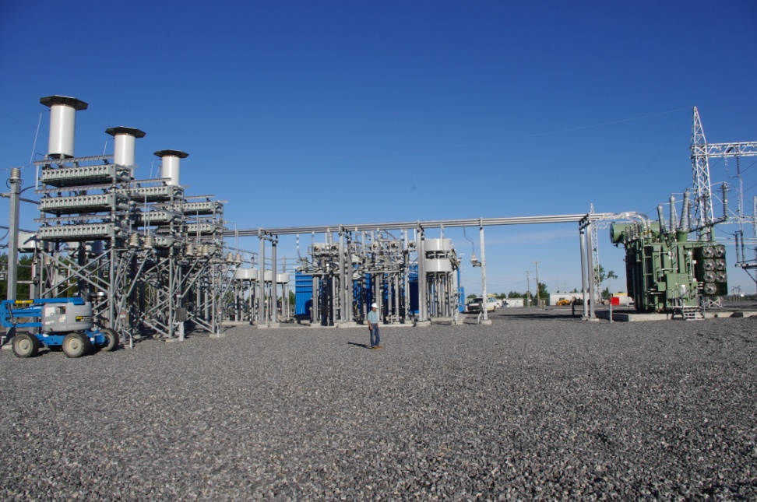

Slide 42
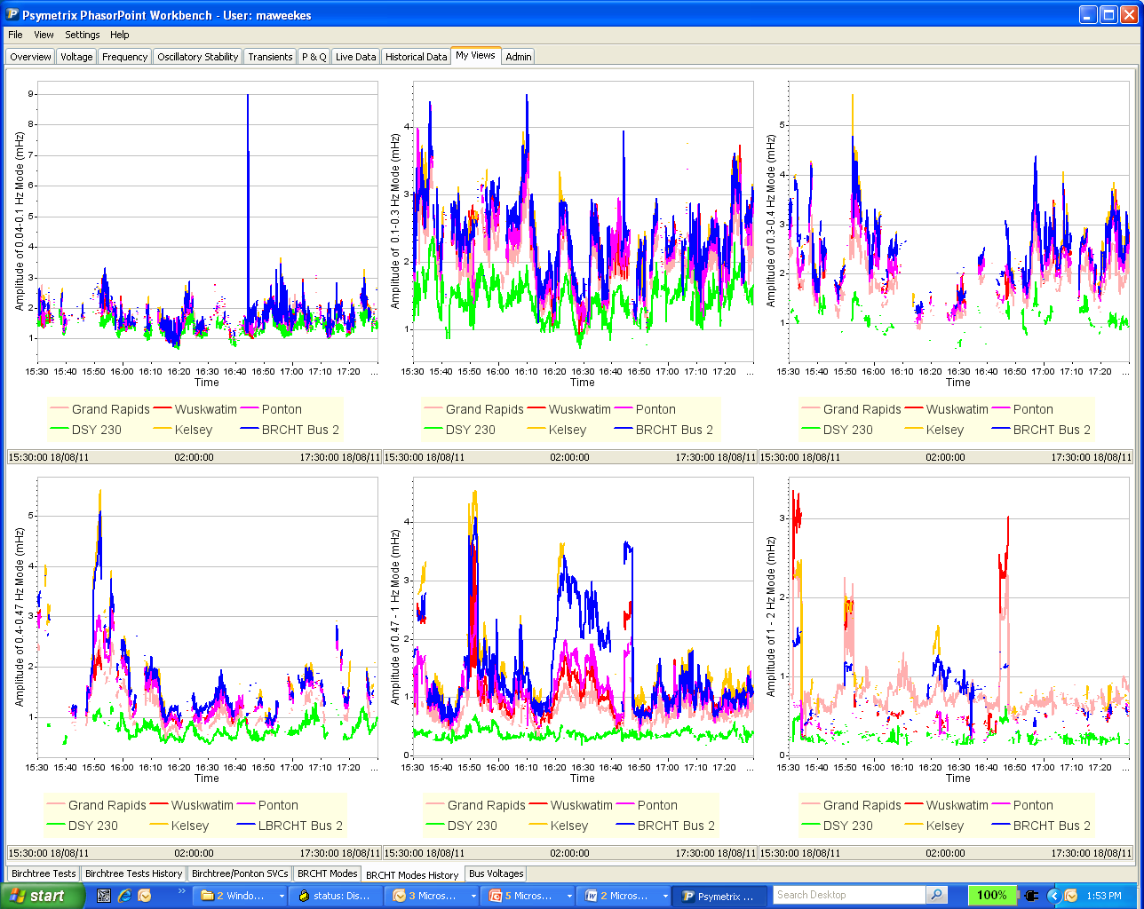
Open/Close Line Test
Notes:
0.7 Hz mode is the most visible

Slide 43
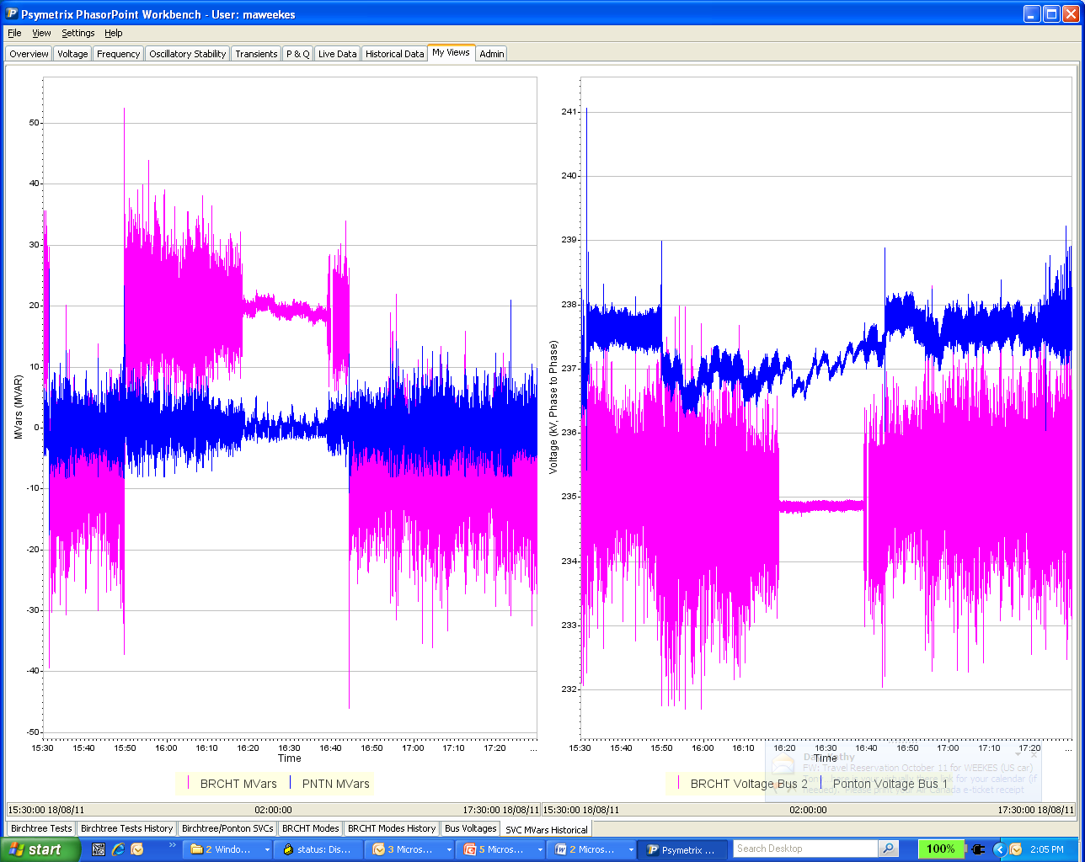
Open/Close Line test
Notes:
One can see when the POD is on the variation is larger. Switching transients are also shown.

Slide 44
Commissioning Plan
Time domain and frequency domain simulation studies
System Baselining (using the PMU and Psymetrix tools)
Test schedule & planning
Commissioning test process
Results analysis

