Slide 1


Entergy Phasor Project Update
Floyd Galvan
fgalvan@entergy.com
October 12-13, 2011

Slide 2
Acknowledgment and Disclaimer
Acknowledgment: This material is based upon work supported by the Department of Energy under Award Number(s) DE-OE0000375
Disclaimer: This report was prepared as an account of work sponsored by an agency of the United States Government. Neither the United States Government nor any agency thereof, nor any of their employees, makes any warranty, express or implied, or assumes any legal liability or responsibility for the accuracy, completeness, usefulness of any information, apparatus, product, or process disclosed, or represents that its use would not infringe privately owned rights. Reference herein to any specific commercial product, process, or service by trade name, trademark, manufacturer, or otherwise does not necessarily constitute or imply its endorsement, recommendation, or favoring by the United States Government or any agency thereof. The views and opinions of authors expressed herein do not necessarily state or reflect those of the United States Government or any agency thereof.

Slide 3

Project Specifics
PMU installations Across Arkansas, Mississippi, Louisiana, and East Texas
  14 New PMU’s installed in 2011
  21 New PMU’s Installed by EOY 2012
  10 New PMU’s installed by EOY 2013
  45 Total DOE Co-Funded PMUs
  ------------------------------------------------
  66 PMUs at Entergy by 2013 (with 21 Existing PMU’s)
28 PMU’s > 345 kV
38 PMU’s < 345 kV

Slide 4

Project Specifics(cont)
Module One E-Learning Training completed by Over 600 Entergy staff and Project Members
Training & Education Plan 2012/13
Beta Applications:
  Phasor Gateway - Testing & Evaluation
  WSU Oscillation Monitoring – Testing & Evaluation
  EPRI Wide-Area Voltage Stability Monitoring – Testing & Evaluation
  NEU Synchro-Phasor Assisted State Estimator (SPASE) – Testing & Evaluation
  UNO Pattern Recognition – CART installed, functional plans and processes have been completed and analysis begun
  WSU Local-Area Voltage Stability- Dec 2011 delivery
  Space Time Insight - Preliminary Visualizations Applications
OSIsoft Pi Historian installed 2007
GPA openPDC installed June 2011, second 2012
Deployment of DOE Approved Cyber Security Plan is in progress and on schedule

Slide 5

Challenges, Lessons Learned
& Everything Else
Entergy and MISO will be testing the use of NERCnet for the exchange of Phasor data
  Gateway to Gateway, PDC to PDC
  Metrics for the tests will include data quality, data delivery, security of data exchange, etc.

Slide 6

Challenges, Lessons Learned
& Everything Else
Things take longer than you think
Guidelines for Visualization components and shared visualizations (colors, symbols, refresh rates, etc)
Agree on Common Training & Education materials
Talk Often, Meet Regularly, & Know Where You’re Going

Slide 7



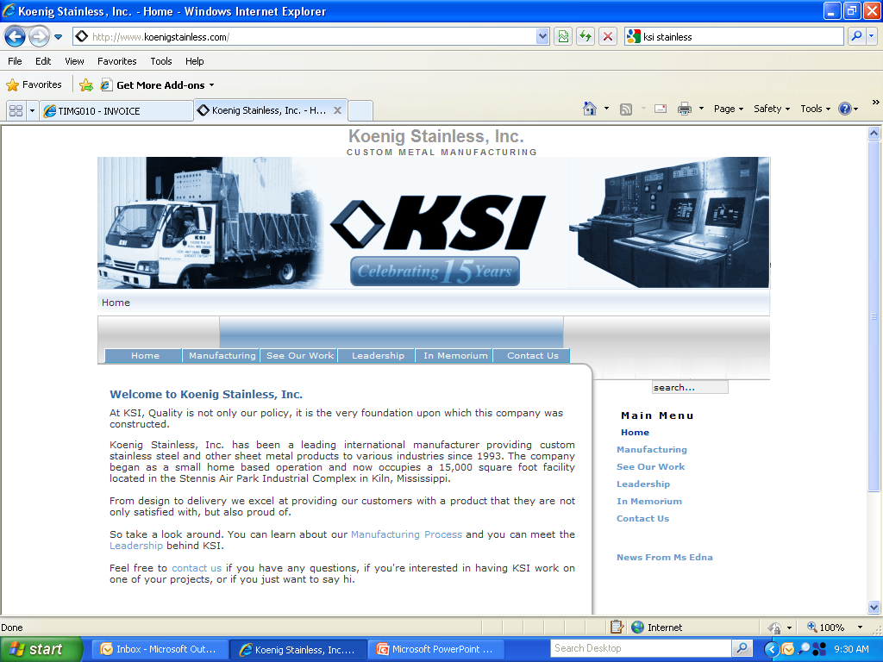



















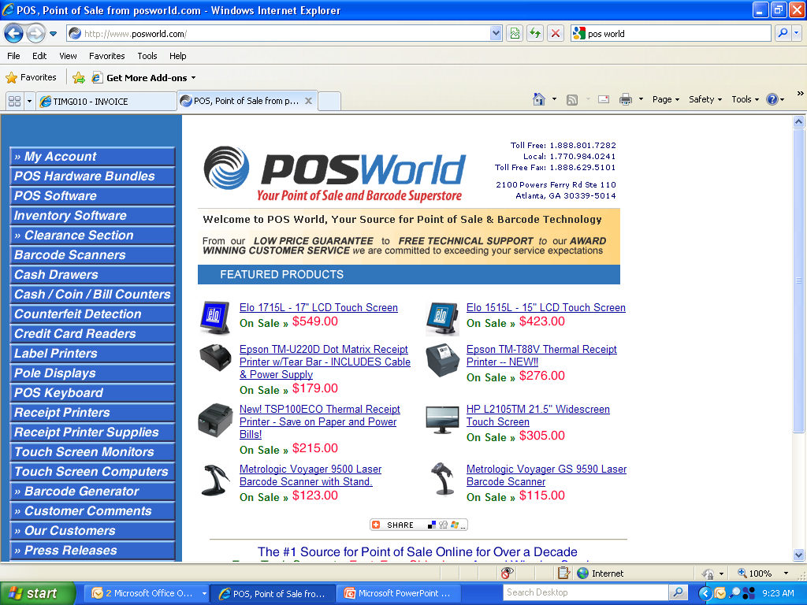





Entergy Services, Inc.
Floyd Galvan, Program Manager – fgalvan@entergy.com
Angela Nelson, Project Manager- PMOlink
Lisa Beard, Technical Consultant – Quanta Technologies
Lynda McGhee, Cyber Security Architect - SAIC

