Slide 1
Interim Report on Customer Acceptance, Retention and Response to Time-Based Rates from the Consumer Behavior Studies
U.S. Department of Energy
Office of Electricity Delivery and Energy Reliability
Notes:
Team members
LBNL: Pete Cappers, Annika Todd, Anna Spurlock, Liesel Hans,
Scheer Ventures LLC: Rich Scheer

Slide 2
Outline
Background on SGIG CBS Projects
Highlights
Follow On Actions of CBS Utilities
Recruitment Approaches
Rebates vs. Pricing
Information and Control Technology
SGIG CBS Program Reporting

Slide 3
Outline
Background on SGIG CBS Projects
Highlights
Follow On Actions of CBS Utilities
Recruitment Approaches
Rebates vs. Pricing
Information and Control Technology
SGIG CBS Program Reporting

Slide 4
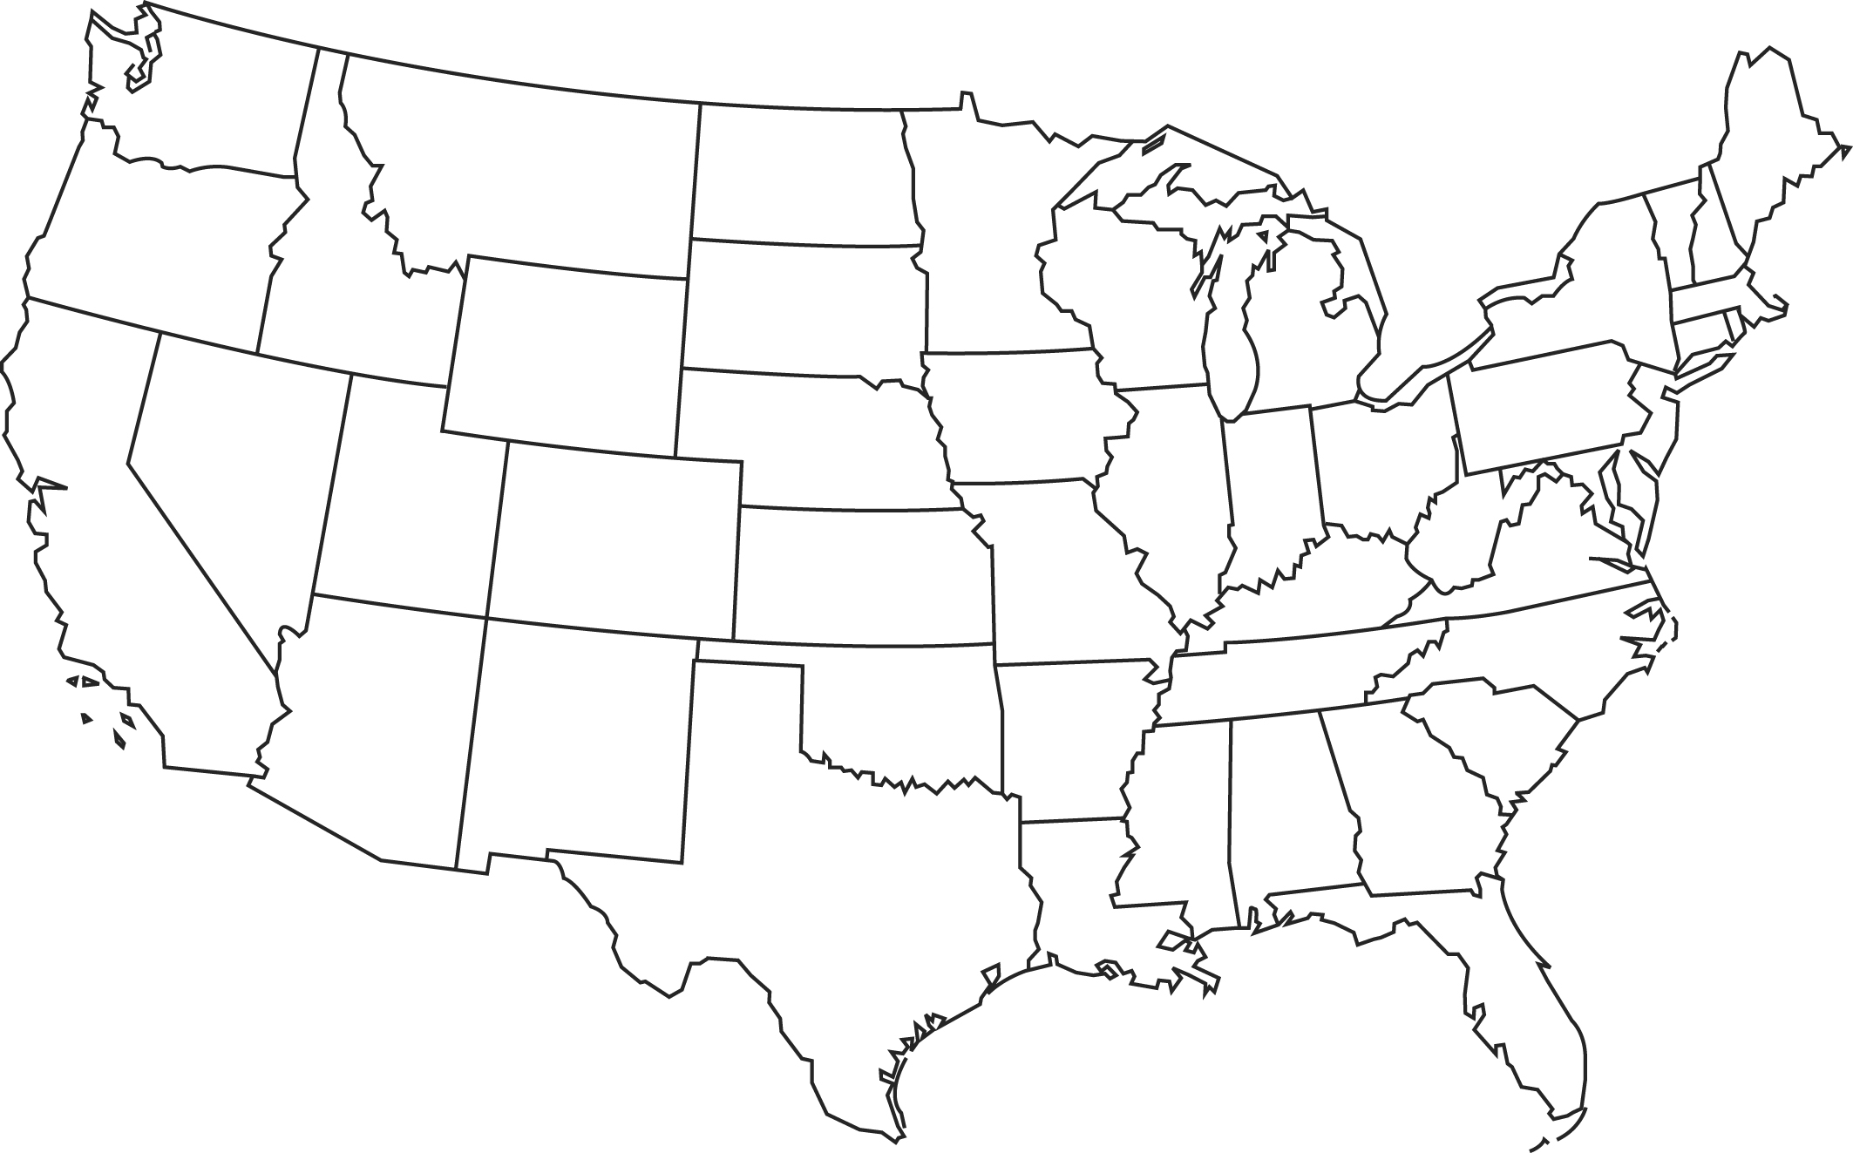
CBS Project Sites
VEC
MNP
GMP
DTE
MMLD
CEIC
SMUD
NVE
OGE
10 Utilities
11 Studies
LE

Slide 5
Rate Treatments Included in Studies
Under CPP/CPR, event hours are set one day ahead and the utility either provides a rebate (CPR) or increases the commodity price (CPP) to induce a load response
CPP/CPR
CPR/

Slide 6
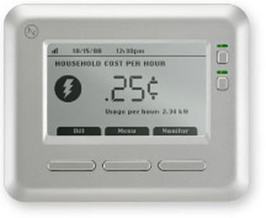
Customer Technology Types
Information Technology
In-Home
Displays (IHD)
Control Technology
Programmable
Communicating
Thermostats (PCT)
Notes:
Different expectations/goals.

Slide 7
Study Overview
 | CEIC | DTE | GMP | LE | MMLD | MP | NVE | OG&E | SMUD | VEC
Rate Treatments
CPP |  | ● | ● |  | ● | ● | ● | ● | ●
TOU |  | ● |  | ● |  | ● | ● | ● | ●
VPP |  |  |  |  |  |  |  | ● |  | ●
CPR | ● |  | ●
Non-Rate Treatments
IHD | ● | ● | ● |  |  |  |  | ● | ●
PCT | ● | ● |  |  |  |  | ● | ●
Education |  |  |  |  |  |  | ●
Recruitment Approaches
Opt-In | ● | ● | ● | ● | ● | ● | ● | ● | ● | ●
Opt-Out |  |  |  | ● |  |  |  |  | ●
Utility Abbreviations: Cleveland Electric Illuminating Company (CEIC), DTE Energy (DTE), Green Mountain Power (GMP), Lakeland Electric (LE), Marblehead Municipal Light Department (MMLD), Minnesota Power (MP), NV Energy (NVE), Oklahoma Gas and Electric (OG&E), Sacramento Municipal Utility District (SMUD), Vermont Electric Cooperative (VEC)
Notes:
8 studies implementing CPP; 6 of them have a CPP overlaid on a TOU
3 studies included both In Home Displays (IHDs) and Programmable Communicating Thermostats (PCTs)
All 11 studies employed an opt-in recruitment approach. Only 2 studies used both an opt-in and opt-out recruitment approach.

Slide 8
Status of Evaluation Reports
CBS Utilities | Initial | Final
CEIC | Q2 2013 | Q2 2015
DTE | Q1 2014 | Q4 2014
GMP | Q4 2013 | Q2 2015
LE | Q2 2015 | Q3 2015
MMLD | Q2 2012 | Q3 2013
MP | Q1 2014 | Q1 2016
NVE | Q2 2015 | Q1 2016
OG&E | Q2 2011 | Q3 2012
SMUD | Q4 2013 | Q4 2014
VEC | Q4 2013 | Q2 2015
Legend
Included in Analysis
Not Included in Analysis
Notes:
The majority of the CBS Utility evaluation reports have been completed and approved by DOE (14 of 20). Due to timing of when the analysis for this report had to begin, we imposed a cut off date of February 28, 2015 for inclusion.

Slide 9
Outline
Background on SGIG CBS Projects
Highlights
Follow On Actions of CBS Utilities
Recruitment Approaches
Rebates vs. Pricing
Information and Control Technology
SGIG CBS Program Reporting

Slide 10
Follow-On Actions of CBS Utilities
CEIC | Still determining in Ohio but useful in Pennsylvania AMI proceeding
DTE | ~75% of CBS population remained on the rate after the study and working w/ PSC to remove customer cap for broad-based deployment
GMP | Filed with the PSC to offer TOU w/ CPP to residential customers
LE | Redesigned existing TOU rate based on study results
MMLD | Nothing yet
MP | Still in the field
NVE | 30-40% of CBS population remained on the rate after the study and working w/ PSC to enable broader roll-out
OG&E | Recruited ~18% of entire residential class so far to take up VPP
SMUD | Plan to offer TOU as default rate starting in 2018
VEC | Nothing yet but may help inform response to recent legislation
Notes:
6 of the 10 utilities have taken their experience with time-based rates through their CBS and parlayed them into actual or planned deployment efforts.

Slide 11
Outline
Background on SGIG CBS Projects
Highlights
Follow On Actions of CBS Utilities
Recruitment Approaches
Rebates vs. Pricing
Information and Control Technology
SGIG CBS Program Reporting

Slide 12
Opt-In vs. Opt-Out Policy Issues
With AMI, metering costs are no longer a barrier to broader deployment of TBR (as has been in the past)
Some consumer advocates and wary utilities are concerned about using an opt-out method for exposing customers to TBR
Are you manipulating people onto a rate that:
They don’t want, and will make them angry and complain
Will hurt them financially or otherwise
They won’t be aware of until it’s too late
Won’t respond at all

Slide 13
Enrollment Rates Opt-out > Opt-In (All studies)
Opt-In
Opt-Out
Notes:
Note that the CBS utilities undertook very different approaches to recruitment. Some expended tremendous resources on market research, others spent nearly nothing on the activity. Some have very positive relationships with their customers, others have a much less positive relationship with their customers. So there are many factors that contribute to the variability in recruitment rates, but it is clear that opt-out recruitment approaches enlist far more customers than opt-in approaches.

Slide 14
Retention Rates Opt-in = Opt-Out (All studies)
Opt-In
Opt-Out
Notes:
Once customers began the study, all were able to leave if they were dissatisfied, but the hurdles required to get out varied by utility. Some utilities provided considerable resources to participating customers to help them cope with this new rate, while others did very little. Some utilities employed bill protections to help mitigate detrimental bill impacts from participation, but these rolled off after 6-12 months. All in all, despite this variability in efforts to retain customers, the recruitment approach seems to have had little impact on the overall level of customer retention in these studies. There was no mass exodus, as some had predicted, when customers realized what they had been defaulted onto.

Slide 15
Event Peak Load Response Opt-in > Opt-out (SMUD)
Notes:
Not surprisingly, those who were engaged enough to volunteer for the study provided larger load reductions on average than those who were defaulted into the study and onto a new time-based rates.

Slide 16
Recruitment Approach Affects Cost-Effectiveness (SMUD)
Recruitment Approach | Scenario Offer | Benefit-Cost Ratio
Opt-in | TOU, no IHD | 1.19
 | TOU, with IHD | 0.74
 | CPP, no IHD | 2.05
 | CPP, with IHD | 1.30
Opt-Out | TOU, with IHD | 2.04
 | CPP, with IHD | 2.22
 | TOU-CPP, with IHD | 2.49
Notes:
However, the sheer increase in participants under opt-out recruitment approaches results in dramatically increased aggregate load impacts and lower customer acquisition costs. So much so, that opt-out offers were found to be more cost-effective than comparable offerings under an opt-in approach.

Slide 17
Recruitment Approach Doesn’t Dramatically Affect Attitudes About TBR by the End (SMUD)
Opt-out participant attitudes to time-based rates were indifferent to positive but not negative
How satisfied are you with your current electricity pricing plan?
 |  | Opt-in CPP | Opt-out CPP | t-stat
 | Very satisfied | 0.302 | 0.317 | -0.376
 |  | (0.019) | (0.034)
 | Somewhat satisfied | 0.588 | 0.568 | 0.476
 |  | (0.021) | (0.037)
 | Somewhat dissatisfied | 0.095 | 0.093 | 0.101
 |  | (0.012) | (0.021)
 | Very dissatisfied | 0.014 | 0.022 | -0.649
 |  | (0.005) | (0.011)
 | Number of respondents | 566 | 183
I want to stay on my pricing plan
 |  | Opt-in CPP | Opt-out CPP | t-stat
 | Strongly agree | 0.498 | 0.301 | 4.687
 |  | (0.022) | (0.036)
 | Somewhat agree | 0.264 | 0.294 | -0.761
 |  | (0.019) | (0.036)
 | No opinion | 0.192 | 0.344 | -3.697
 |  | (0.017) | (0.037)
 | Somewhat disagree | 0.029 | 0.031 | -0.104
 |  | (0.007) | (0.014)
 | Strongly disagree | 0.017 | 0.031 | -0.901
 |  | (0.006) | (0.014)
 | Number of respondents | 516 | 163
Test of Equality
Share of respondents
Standard error
Test of Equality
Notes:
Since customers can walk with their feet during the study and we saw not many did regardless of recruitment approach, it is not surprising that the recruitment approach didn’t seem to be a deciding factor on satisfaction with the study rates. More importantly, once exposed to the rate, these customers who responded to the survey and were defaulted onto the study and the rate were either indifferent to positive about staying on the rate. For these customers, defaulting them onto the rate appears to have helped the majority of them see that time-based rates weren’t so bad and for many was actually something positive.

Slide 18
Outline
Background on SGIG CBS Projects
Highlights
Follow On Actions of CBS Utilities
Recruitment Approaches
Rebates vs. Pricing
Information and Control Technology
SGIG CBS Program Reporting

Slide 19
Prices vs. Rebates Policy Issues
Some in the electric industry want efficient price signals sent to customers to inform consumption decisions
Price goes up, demand should go down
Others are concerned about using TBR to reduce peak demand
Bill volatility during high priced events/seasons
Lack of ability to respond to mitigate bill impacts
Prefer to pay rebates for load reductions than exposing 100% of a customers’ load to high prices
These programs are intended to reduce peak demands which drive capacity obligations
The variability and dependability of the load response is important to assess value and cost effectiveness
Notes:
If utilities have a goal of peak load reduction, there are a number of ways in which they can go about getting it. Economists focus on setting prices to reflect the high cost of peak electricity. However, some in our industry are wary about this approach. They prefer to pay customers to alter their behavior instead of exposing their entire load to these high prices.

Slide 20
Enrollment & Retention Rates CPR ≥ CPP (GMP)
Notes:
Green Mountain Power expected enrollment rates to be 80% for their CPR offering and only 15% for their CPP offering. As the figured illustrates, customers initially enrolled at about the same rates regardless of the offering. Even once they had a year’s experience on the rate, the difference in retention rates are not all that different either.

Slide 21
Peak Demand Reductions CPP > CPR (All studies)
Notes:
As expected, though, CPP produced much larger load reductions than CPR – nearly twice as large.

Slide 22
Variability of Peak Demand Reductions Across Events: CPP > CPR (All studies)
Relatively high variability
Relatively low variability
Notes:
More importantly, CPP produced load reductions that were more reliable and predictable than those induced from CPR. Using the NYISO’s performance methodology they employ for their capacity DR program participants, all load reductions generated under CPP would have been derated by ~10% when determining how much capacity they represented. However, under CPR, the load reductions would have been derated by 40%. So not only is the utility getting less per customer with CPR they are going to receive less credit from the bulk power system operator and/or reliability organization if they want to apply that against their capacity requirement. This suggests that the value of a CPR program is less than the value from a CPP program, however none of our utilities performed a benefit-cost analysis to definitely illustrate this.

Slide 23
Reliability/Predictability of Peak Demand Reductions: CPP > CPR (All studies)
Notes:
Using the NYISO’s performance methodology they employ for their capacity DR program participants, all load reductions generated under CPP would have been derated by ~10% when determining how much capacity they represented. However, under CPR, the load reductions would have been derated by 30%. So not only is the utility getting less per customer with CPR they are going to receive less credit from the bulk power system operator and/or reliability organization if they want to apply that against their capacity requirement. This suggests that the value of a CPR program is less than the value from a CPP program, however none of our utilities performed a benefit-cost analysis to definitely illustrate this.

Slide 24
Outline
Background on SGIG CBS Projects
Highlights
Follow On Actions of CBS Utilities
Recruitment Approaches
Rebates vs. Pricing
Information and Control Technology
SGIG CBS Program Reporting

Slide 25
Info and Control Tech Policy Issues
If knowledge is power, then IHDs should enable customers to become more engaged and increase capabilities to respond to TBR
PCTs make it easier for customers to alter their electricity use in response to TBR
In both cases, they cost money to procure, provision, install and maintain
Utilities must assess if they are cost effective ways to augment load response from TBR

Slide 26
Enrollment & Retention Rates w/IHD = w/o IHD (SMUD)
Notes:
DTE, GMP, and SMUD all included an IHD in their study. In all cases (although only SMUD is shown), the differences in enrollment and retention rates with and without offers of IHDs were small and did not appear to boost enrollment or retention rates, as many in industry expected they would.

Slide 27
Experiences with IHDs (SMUD)
Treatment Group | % Connected All the Time | % Connected Some of the Time | % Never Connected
Opt-in CPP, IHD Offer | 11.6% | 27.4% | 61.0%
Opt-in TOU, IHD Offer | 11.6% | 22.8% | 65.6%
Default TOU-CPP, IHD Offer | 18.8% | 39.3% | 42.0%
Default CPP, IHD Offer | 14.3% | 42.9% | 42.9%
Default TOU, IHD Offer | 18.2% | 23.1% | 58.7%
Notes:
SMUD tracked the connectivity of IHDs to better understand the degree to which customers were using them. The table shows that less than 20% of the customers who received an IHD actually had it connected to the utility’s system all the time. Instead, the majority of participants in three of the five treatment groups who received an IHD never actually turned it on and connected it to the utility’s system. Brings into question the cost effectiveness of handing out this type of technology if the majority of people are not even turning it on, let alone using it.

Slide 28
Demand Reductions for CPP w/IHD = w/o IHD (SMUD)
Notes:
Many studies have been done on information technology, like IHDs, and most show only a very small if any boost in the level of load reductions that can be attributed to the device. The results from SMUDs study conform with these results, however they offer an interesting caveat. Although the SMUD study derived these estimates of the demand impacts from CPP and IHDs in a truly experimental setting (contrary to many studies that preceded this one), the report points out that these impacts are not statistically different from each other. Furthermore, once pre-treatment differences in the two populations of customers (w/ IHDs and w/o IHDs) are corrected for, the IHD is no longer found to produce any measurable boost in response.

Slide 29
Info Tech Offering Reduces Cost-Effectiveness of TBR (SMUD)
Recruitment Approach | Scenario Offer | Benefit-Cost Ratio
Opt-in | TOU, no IHD | 1.19
 | TOU, with IHD | 0.74
 | CPP, no IHD | 2.05
 | CPP, with IHD | 1.30

Slide 30
Retention Rates w/PCTs = w/o PCTs (All studies)
Notes:
Because of the way the CBS utilities designed the PCT treatments, it was not possible to assess the impacts on enrollment rates. The Figure shows retention rates after the first year for 8 treatment groups with PCTs, compared with 28 treatment groups without PCTs. These data reflect results for 8 CBS utilities. While the overall results vary somewhat, the average retention rates with and without PCTs are about the same: approximately 92% for those with PCTs, and about 90% for those without.

Slide 31
Demand Reduction for CPP & CPR w/PCT > w/o PCT (All studies)
Notes:
While PCT offers did not appear to affect retention rates much, several of the CBS utilities found that demand reductions were higher for customers with PCTs than for those without. The figure shows results for 8 CBS utilities encompassing 45 treatment groups and covers demand reductions for critical peak events involving CPP and CPR. The estimated demand reductions for customers with PCTs ranged from about 27% to 45%; while the estimated demand reductions for customers without PCTs ranged from about -1% to 37%.

Slide 32
Variability of Peak Demand Reductions Across Events: w/PCT > w/o PCT (All studies)
Notes:
While PCTs generally increased the average level of demand reductions, if the devices also led to less variability in demand reductions, then the value would be increased further because of greater confidence by grid operators in the certainty of the resource. The figure shows results from 3 CBS utilities and 13 CPP treatment groups.

Slide 33
Reliability/Predictability of Peak Demand Reductions: w/PCT > w/o PCT (All studies)
Notes:
Using NYISO’s performance factor methodology described in Chapter 4, shows that grid operators would derate the average demand reduction 7% for CPP customers with PCTs, and 15% for customers without PCTs. These results suggest that PCTs do reduce the level of variability of demand reductions associated with rates and programs.

Slide 34
Cost Effectiveness of VPP w/ PCTs (OG&E)
Benefit-Cost Ratios
Participant Test | 1.50
Rate Impact Measure Test | 1.01
Total Resource Cost Test | 1.18
Societal Test | 1.18
Program Administrator Cost Test | 1.11
Notes:
OG&E conducted cost-effectiveness analysis of a broad roll out of its tested VPP rate offering which included offers of PCTs at no cost to participating customers. The table shows positive benefit-cost ratios for all of the standard practice manual tests that are commonly applied to assess cost effectiveness of DSM programs. Based on these findings, OG&E filed a request, which was approved by the Oklahoma Corporation Commission, to roll-out the VPP rate offering with free PCTs under an opt-in recruitment approach with the goal of enrolling 120,000 (~20%) of its residential and small commercial customers across its service territory within 3 years.

Slide 35
Systems Integration and Equipment Capabilities Problems
Many CBS utilities experienced challenges getting MDMS, CIS, OMS and billing systems to work together seamlessly with IHDs & PCTs
End-to-end testing and detailed process flows developed during the planning phase of the studies helped many mitigate or remedy issues
Many vendors oversold and under-delivered products and support services
Several utilities avoided these challenges because they dedicated the time and resources during the planning phase to ensure the equipment did what is was supposed to do

Slide 36
Outline
Background on SGIG CBS Projects
Highlights
Follow On Actions of CBS Utilities
Recruitment Approaches
Rebates vs. Pricing
Information and Control Technology
SGIG CBS Program Reporting

Slide 37
Two Types of Analysis
CBS Program Impacts
Use the findings in the CBS projects' evaluation reports to provide a summary of results across all CBS utility projects
“Deep-dive” Evaluation of Targeted Policy Issues
Perform an independent analysis of the CBS projects' raw data to address specific policy issues of important to industry

Slide 38
CBS Program Impact Reports
An assessment of (to the extent findings are included in the CBS Projects' evaluation reports):
Customer acceptance and attrition
Customer load impacts
Utility cost effectiveness
Timing of Reports
Interim: Q2 2015 (Released by end of May)
Final: Q1 2016

Slide 39
“Deep-dive” Evaluation of Targeted Policy Issues Reports
Topics | Publication Dates
Utility engagement of consumers: Best practices and lessons Learned | Q4 2014
Identifying customer biases toward opt-out (default) approaches to enrollments in time-based rate programs | Q2 2015
Effects of time-based rates on vulnerable customer groups (e.g., low income and the elderly). | Q4 2015
Spillover benefits from time-based rates and inter-temporal demand impacts. | Q4 2015
Relative merits of alternative experimental designs for studies and evaluations of time-based rates. | Q1 2016

Slide 40
Questions/Comments
Peter Cappers
(315) 637-0513
pacappers@lbl.gov

