Slide 1
OG&E’s Smart Study TOGETHER: Impact Assessment of Enabling Technologies and Dynamic Pricing Rates
Katie Chiccarelli, Craig Williamson
January 24, 2012

Slide 2
Agenda
Program Background
Program Design (Rate/Technology)
2010 DR Study
Hypothesis, results
2011 DR Study
Results
Phase I vs. Phase II participants
What do there results mean?
What rate/technology = load savings
Can we defer generation?

Slide 3
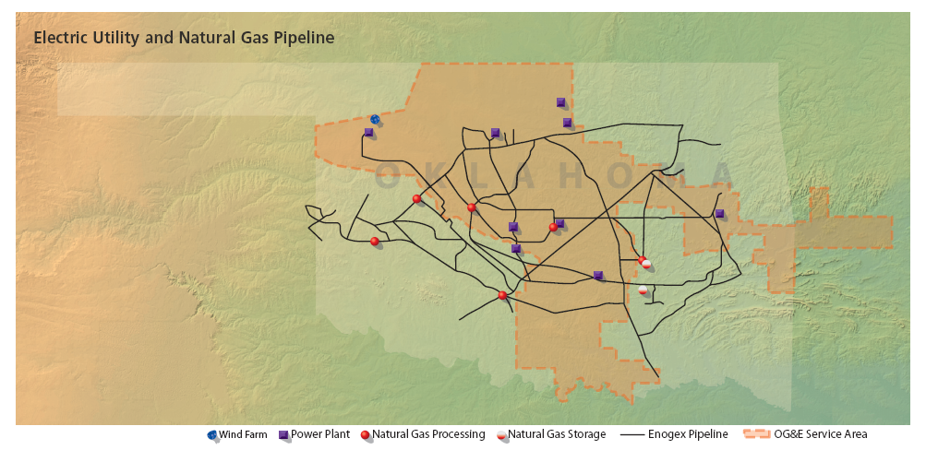
OG&E
9 power plants: 6.8 GW
778 MW - wind
765k customers in OK & AK
30k square mile service area
23k miles of overhead distribution lines
500 substations
1100 distribution circuits

Slide 4
Smart Grid Program
This material is based upon work supported by the Department of Energy under Award Number DE-OE0000206 and Project Number - 09-0111
This report was prepared as an account of work sponsored by an agency of the United States Government. Neither the United States Government nor any agency thereof, nor any of their employees, makes any warranty, express or implied, or assumes legal liability or responsibility for the accuracy, completeness, or usefulness of any information, apparatus, product, or process disclosed, or represents that its use would not infringe privately owned rights. Reference herein to any specific commercial product, process, or service by trade name, trademark, manufacturer, or otherwise does not necessarily constitute or imply its endorsement, recommendation, or favoring by the United States Government or any agency thereof. The views and opinions of authors expressed herein do not necessarily state or reflect those of the United States Government or agency thereof.

Slide 5
Smart Grid Demand Response Background
Quail Creek
2010 Study
3,000 Customers
2011 Study
Dynamic Segmentation
Pilot
Implement Dynamic Segmentation
New Pricing Products
Product
Acceptance
Energy Awareness
Reduced Peak
Acceptance
Technology
Dynamic Pricing
Commercial Results
Critical Price Results
Penetration Testing
Value-Added Products + Services
70 MW
210 MW
Segment Results
6,000 Customers
~40 K Customers
20% customer participation by Dec. 2014
25 Customers

Slide 6
Study Design—Price Plans
VPP
TOU
4.5¢/kWh
Off-Peak/Low
4.2¢/kWh
11.3¢/kWh
Standard
23¢/kWh
23¢/kWh
High
46¢/kWh
Critical
46¢/kWh
Critical Price Event
46¢/kWh

Slide 7
Study Design—Price Plans
VPP
TOU
4.5¢/kWh
Off-Peak/Low
4.2¢/kWh
11.3¢/kWh
Standard
23¢/kWh
23¢/kWh
High
46¢/kWh
Critical
46¢/kWh
Critical Price Event
46¢/kWh

Slide 8
Study Design—Price Plans
VPP
TOU
4.5¢/kWh
Off-Peak/Low
4.2¢/kWh
11.3¢/kWh
Standard
23¢/kWh
23¢/kWh
High
46¢/kWh
Critical
46¢/kWh
Critical Price Event
46¢/kWh

Slide 9
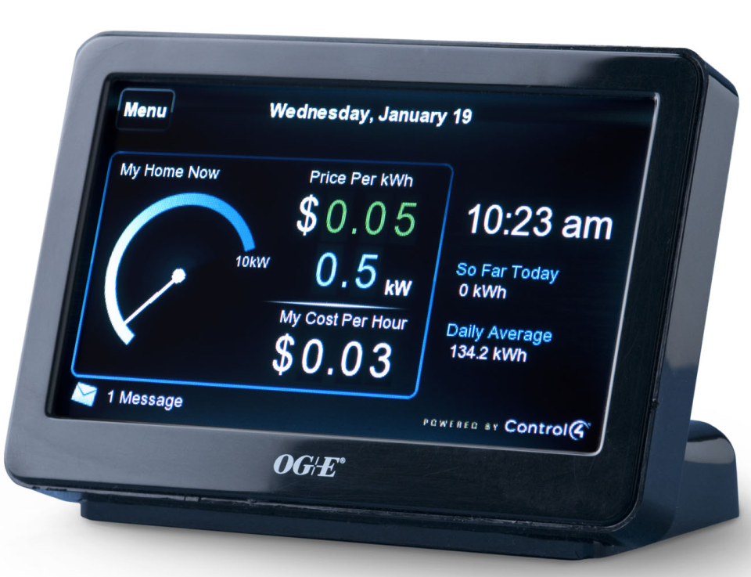
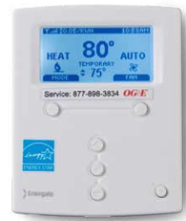
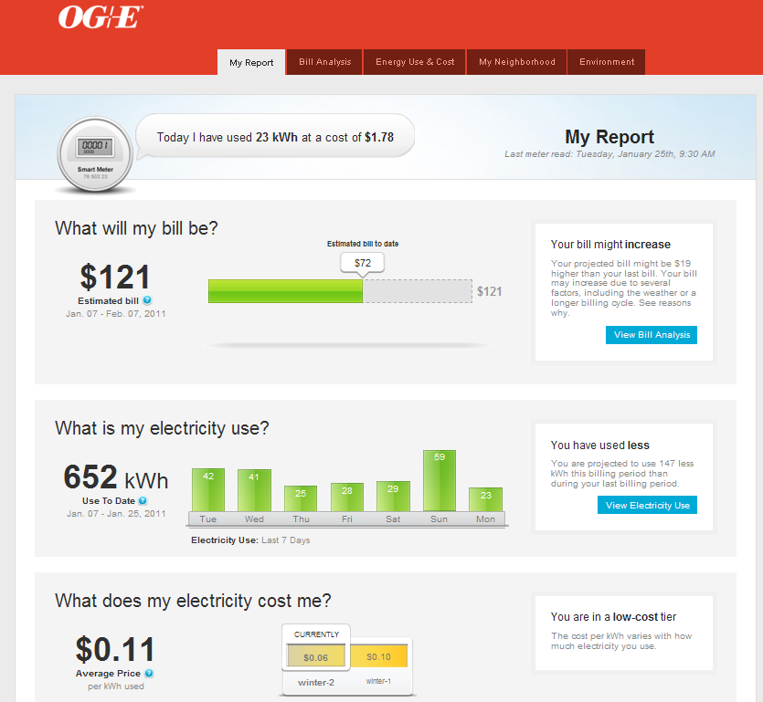
Study Design- Technology
Energate Pioneer
Silver Spring Networks

Slide 10
DR Study Hypothesis
20% Participation by December 2014
150K customers (50k per year)
1.33 kW per customer (~70 mW per year)
Notes:
With these two pieces we aim to have 210 mW of demand reduction (which is 3% of our projected system peak) by the end of 2014, and therefore avoid building incremental generation until the year 2020

Slide 11
2010 Study Results

Slide 12
2010 Study Results Validate Hypothesis
VPP rate combined with PCT enabling technology maximizes load reduction
 | VPP-CP Critical Weekday Max DR | TOU-CP Average Weekday Max DR
Web | 0.51 kW | 0.33 kW
IHD | 0.47 kW | 0.54 kW
PCT | 1.96 kW | 1.25 kW
Notes:
You can see here that the TOU/PCT treatment gave us 1.25 kW, the PCT/VPP treatment gave us 1.96 on a 46 cent day, which is comparable to the 1.3 from our hypothesis. So this is a great result.

Slide 13
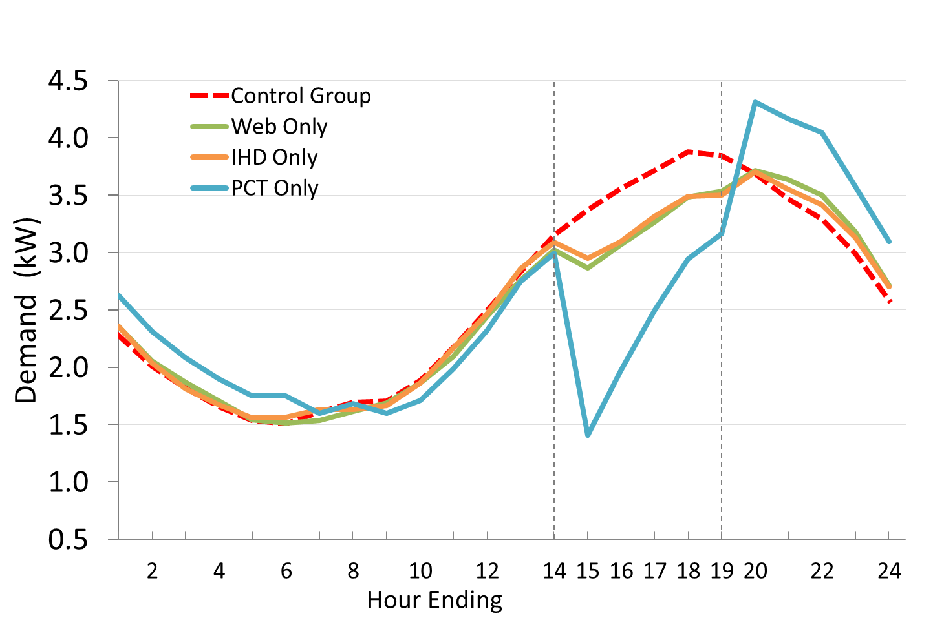
2010 Results – VPP Critical Price Weekday
Notes:
Note that this increase in the off peak hours looks like we are creating a new peak. OG&E peaks at 5pm, after which enough C&I load is coming offline that we are not concerned with creating a new system peak

Slide 14
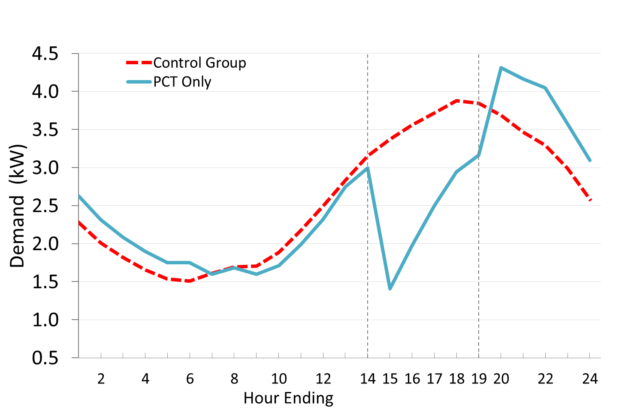
2010 Results
System Peak
Max Reduction
Notes:
Max demand reduction of 1.96 kW happens at 3pm. To avoid building generation we need to shave SYSTEM peak which occurs at 5pm.

Slide 15
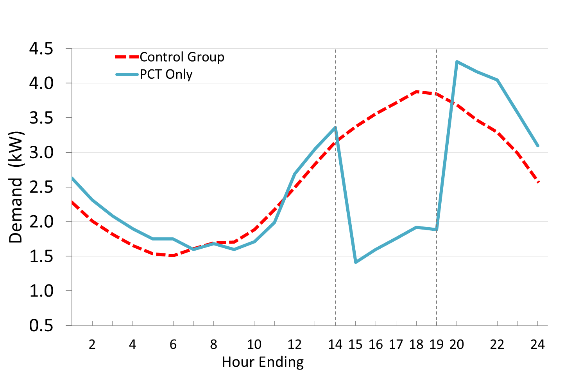
Desired Results
Notes:
Desired result is to flatten that line in the on peak period. Ways to aid this:
Precooling
Weatherization program
Change in rates

Slide 16
Shifting and Conservation
kWh Change, VPP-CP Critical Weekday |  |  | kWh Change, TOU-CP Average Weekday
 | On Peak kWh | Off Peak kWh | On Peak kWh | Off Peak kWh
Web | -2.15 | 0.43 | -1.49 | 0.41
IHD | -2.02 | 0.50 | -2.51 | -1.81
PCT | -6.43 | 3.74 | -4.41 | 1.25
Notes:
PCT/VPP participants reduced on peak by 6 but 4kWh were shifted into the off peak period.
TOU, and in particular the IHD treatment, shows load savings @ all times, almost as much decrease in consumption off peak as their was on peak

Slide 17
VPP Demonstrates Price Elasticity
 | On Peak Price | Maximum Demand Reduction
 |  | Baseline | Reduction | Percent
VPP Low | 4.5 ¢ | 2.35 | 0.41 | 18%
VPP Standard | 11.3 ¢ | 2.45 | 1.11 | 45%
VPP High | 23 ¢ | 3.08 | 1.68 | 55%
VPP Critical | 46 ¢ | 3.37 | 1.96 | 58%
Notes:
As price increased, the reduction increased on a kW basis AND a % basis

Slide 18
2011 Study Results

Slide 19
2011 study results
Results from 2011 confirm 2010
Load shapes changed, Demand Reduction approx. the same (2010 v. 2011)
Strategically called events can
Stretch out savings
Add secondary bump to savings closer to the system peak
2011 Summer was HOT!
Notes:
Impossible to tell how much due to weather and how much due to learning, other factors
VPP price influences event savings
Very little if already Critical Price
Adds secondary bump if low, medium, or high price
Weather influences load and savings

Slide 20
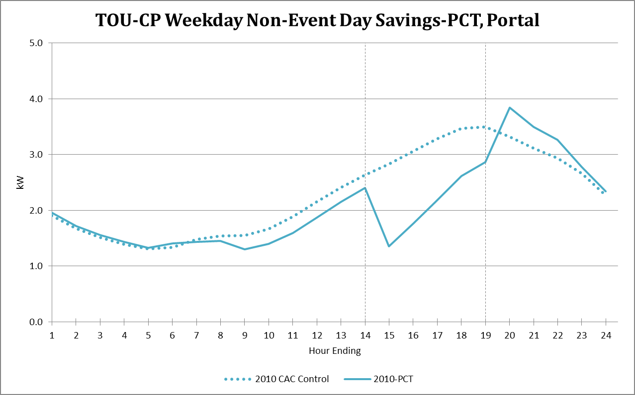
2010 versus 2011 Impacts-TOU-CP
Notes:
For the participants recruited in 2010, we now compare how they responded in 2010 with how they responded in 2011. These graphs represent the same customers for both summers.
TOU is based on all weekdays

Slide 21
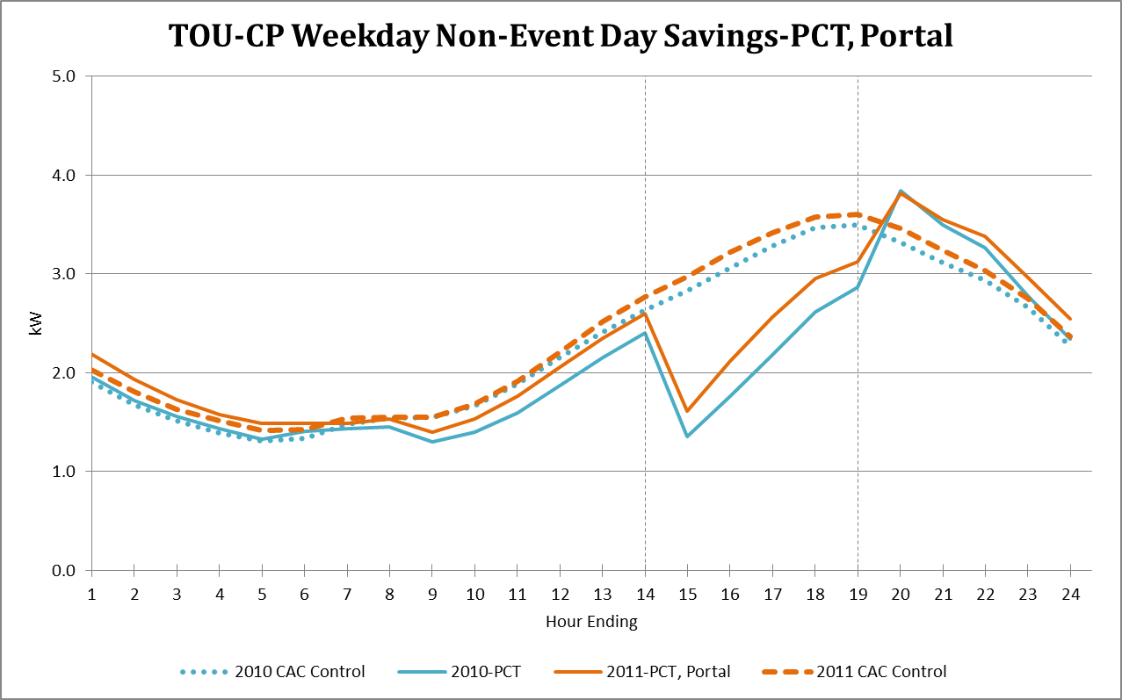
2010 versus 2011 Impacts-TOU-CP
Notes:
The 2011 usage is slightly higher for both the participants and the control group, but the nature of their energy use and the savings are similar.
Off Peak Prices:
Treatment: 4.2 cents
Control: 8.4-9.7 cents
On Peak Prices:
Treatment: 23 cents
Control: 8.4-9.7 cents

Slide 22
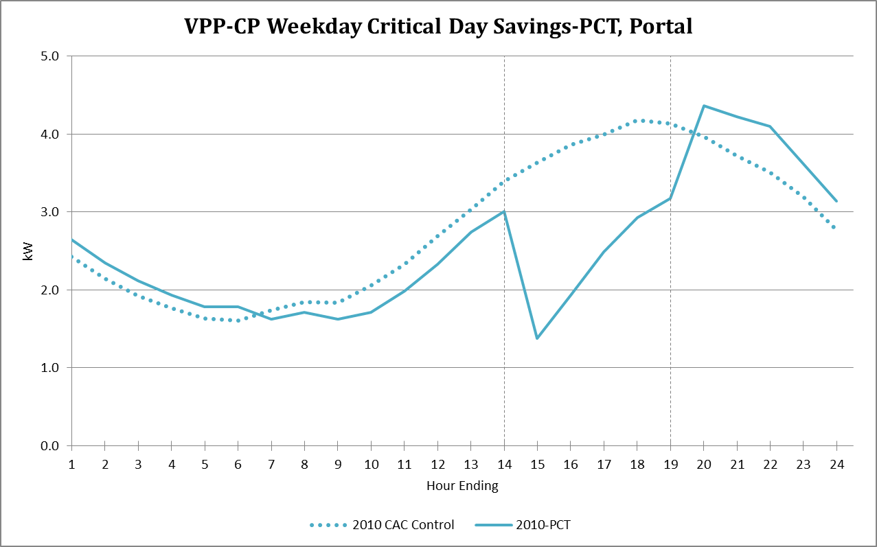
2010 versus 2011 Impacts-VPP-CP
Notes:
We now look at the VPP-CP customers on the highest-price days, when the day ahead price was set at 46 cents

Slide 23
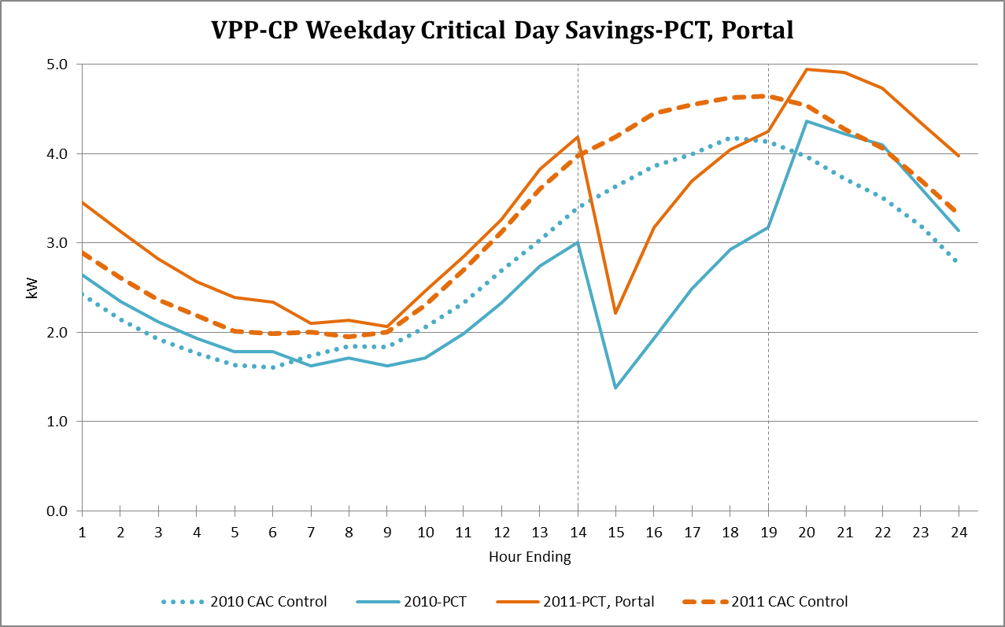
2010 versus 2011 Impacts-VPP-CP
Notes:
VPP Critical price days – higher usage in 2011. Possible reasons:
much hotter in 2011 means higher baseline, less savings.
Highest-price days in 2011 were all in sequence, so there may be residual heat
Less tolerance for discomfort?
Could be that customers are learning off peak energy is low-priced.
Off Peak Prices:
Treatment: 4.5 cents
Control: 8.4-9.7 cents
On Peak Prices:
Treatment: 46 cents
Control: 8.4-9.7 cents

Slide 24
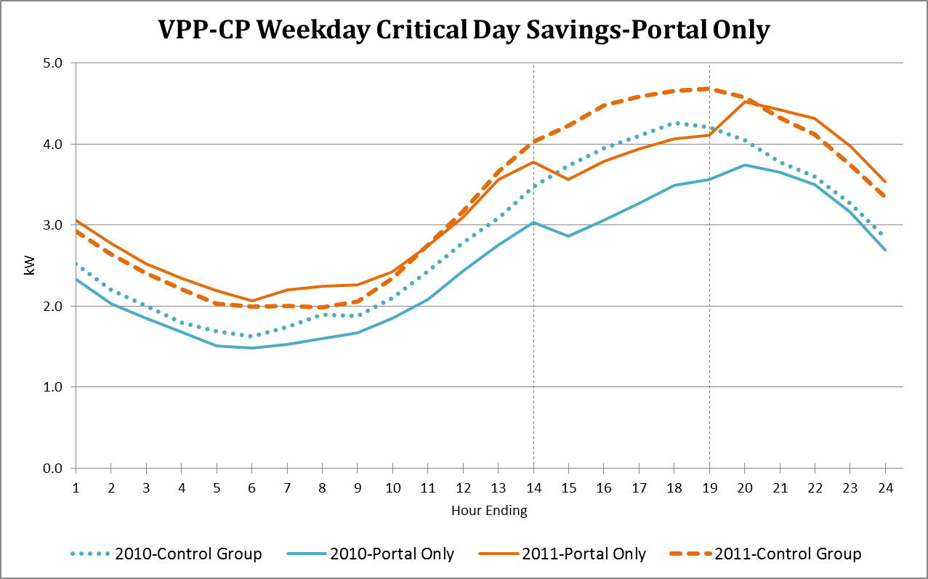
2010 versus 2011 Impacts-VPP-CP
Notes:
Similar differences for Portal only – more savings, less total load in 2010.
Off Peak Prices:
Treatment: 4.5 cents
Control: 8.4-9.7 cents
On Peak Prices:
Treatment: 46 cents
Control: 8.4-9.7 cents

Slide 25
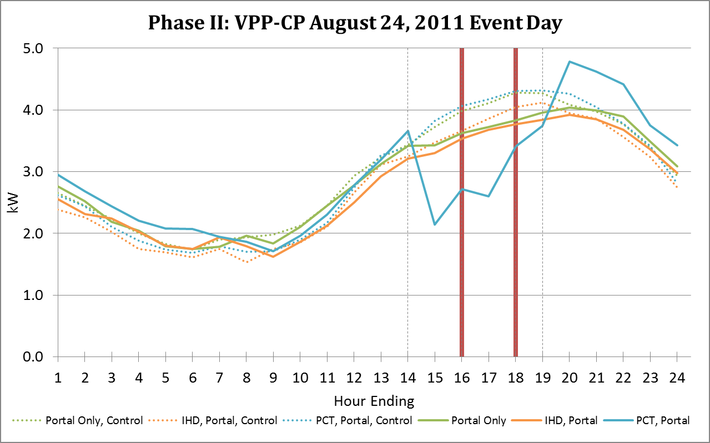
Event Day Savings–Short Event
Notes:
7 events were called with a variety of starting times, durations, and notice times, and on differently-priced VPP-CP days.
This graph represents a day on which a critical peak event was called. The maroon lines represent the start and end of the event.
Notice of event was given the day before
High of 107 degrees.
Off Peak Prices:
Treatment: 4.5 cents
Control: 8.4-9.7 cents
On Peak Prices: (2-4 and 6-7 pm)
Treatment: 23 cents
Control: 8.4-9.7 cents
Critical Event Prices (4-6pm)
Treatment: 46 cents
Control: 8.4-9.7 cents
Savings are almost identical at hour-ending 15 and hour-ending 17 – replicates maximum savings at system peak time
This shows exactly what Katie described that was needed – maximize the reduction at the time of the peak.
Also note that this secondary bump in savings is only present for the PCT group, which has the automated response. There is no comparable bump in the IHD or Portal groups.

Slide 26
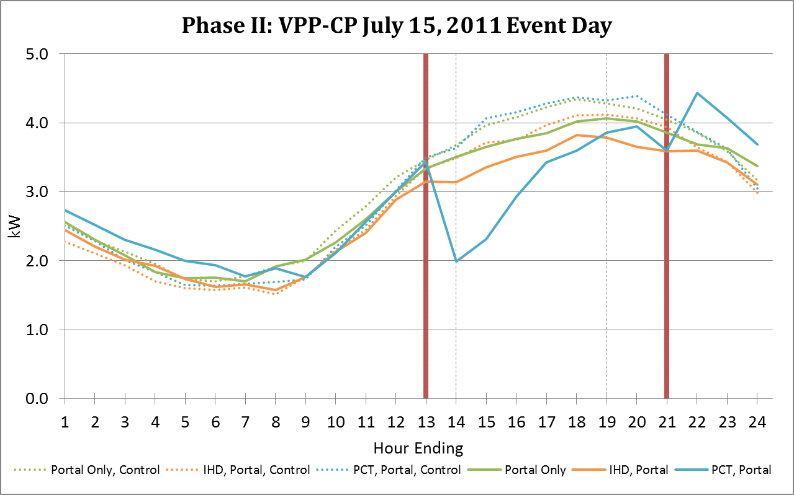
Event Day Savings–Longer Event
Notes:
This graph is representative of an early event start time.
Notice was given to customers 3 hours in advance of event
High temp of 103 degrees.
Off Peak Prices:
Treatment: 4.5 cents
Control: 8.4-9.7 cents
On Peak Prices: (N/A)
The critical event spans across this on peak period.
Critical Event Prices (1-9pm)
Treatment: 46 cents
Control: 8.4-9.7 cents
Savings are stretched out longer, but still decay toward end. Rebound is shifted later.

Slide 27
Conclusion
Potentially Avoid Future Generation
Study results show a 1.3 kW reduction per customer is possible. Participation targets will achieve goal
Event calling enables reduction at time of peak
Plans for 2012
~40k customers enrolled in SmartHours
72 mW reduction
Discontinue roll out of IHD

Slide 28
Katie Chiccarelli chiccakl@oge.com Craig Williamson cwilliamson@enernoc.com

Slide 29
Appendix

Slide 30
2010 Summary: Rate & Technology Combinations
Rate/Technology | Baseline kWh Usage | kWh Savings | % Savings | Average kW Reduction | Peak kW Reduction
TOU-CP Non-Event Weekend
PCT Only | 16.76 | 0.28 | 1.67% | 0.06 | 0.10
IHD Only | 16.76 | 1.37 | 8.17% | 0.27 | 0.35
All | 16.76 | 0.57 | 3.43% | 0.11 | 0.16
Web Only | 16.76 | 0.44 | 2.63% | 0.09 | 0.16
TOU-CP Non-Event Weekday
PCT Only | 14.85 | 4.43 | 29.87% | 0.89 | 1.26
IHD Only | 14.85 | 2.45 | 16.47% | 0.49 | 0.52
All | 14.85 | 3.89 | 26.21% | 0.78 | 1.11
Web Only | 14.85 | 1.61 | 10.86% | 0.32 | 0.35
VPP-CP Low Weekend
PCT Only | 16.76 | -0.12 | -0.71% | -0.02 | 0.06
IHD Only | 16.76 | 0.35 | 2.11% | 0.07 | 0.14
All | 16.76 | 0.27 | 1.60% | 0.05 | 0.09
Web Only | 16.76 | 0.62 | 3.67% | 0.12 | 0.19
VPP-CP Low Weekday
PCT Only | 11.60 | 1.28 | 11.07% | 0.26 | 0.34
IHD Only | 11.60 | 1.29 | 11.13% | 0.26 | 0.29
All | 11.60 | 1.43 | 12.36% | 0.29 | 0.34
Web Only | 11.60 | 1.52 | 13.07% | 0.30 | 0.33

Slide 31
2010 Summary: Rate & Technology Combinations
Rate/Technology | Baseline kWh Usage | kWh Savings | % Savings | Average kW Reduction | Peak kW Reduction
VPP-CP Standard
PCT Only | 14.09 | 3.08 | 21.85% | 0.62 | 1.07
IHD Only | 14.09 | 0.89 | 6.28% | 0.18 | 0.19
All | 14.09 | 2.84 | 20.18% | 0.57 | 0.93
Web Only | 14.09 | 1.07 | 7.59% | 0.21 | 0.25
VPP-CP Medium
PCT Only | 17.13 | 5.01 | 29.24% | 1.00 | 1.64
IHD Only | 17.13 | 1.38 | 8.04% | 0.28 | 0.29
All | 17.13 | 4.39 | 25.63% | 0.88 | 1.38
Web Only | 17.13 | 1.41 | 8.26% | 0.28 | 0.32
VPP-CP High
PCT Only | 18.37 | 5.98 | 32.55% | 1.20 | 1.92
IHD Only | 18.37 | 1.96 | 10.65% | 0.39 | 0.45
All | 18.37 | 5.20 | 28.29% | 1.04 | 1.63
Web Only | 18.37 | 2.16 | 11.76% | 0.43 | 0.51

Slide 32
2010 Peak Savings by Income: VPP-CP High
Income Group | Baseline kWh Usage | kWh Savings | % Savings | Average kW Reduction | Peak kW Reduction
Low
PCT Only | 14.85 | 7.10 | 47.84% | 1.42 | 1.95
IHD Only | 14.85 | 0.75 | 5.07% | 0.15 | 0.20
All | 14.85 | 2.96 | 19.93% | 0.59 | 1.14
Web Only | 14.85 | 1.88 | 12.65% | 0.38 | 0.53
Middle
PCT Only | 16.88 | 3.48 | 20.63% | 0.70 | 1.65
IHD Only | 16.88 | 2.33 | 13.82% | 0.47 | 0.57
All | 16.88 | 5.06 | 29.99% | 1.01 | 1.61
Web Only | 16.88 | 1.63 | 9.68% | 0.33 | 0.38
High
PCT Only | 21.87 | 7.14 | 32.63% | 1.43 | 2.15
IHD Only | 21.87 | 3.02 | 13.83% | 0.60 | 0.63
All | 21.87 | 8.02 | 36.67% | 1.60 | 2.24
Web Only | 21.87 | 3.03 | 13.84% | 0.61 | 0.69

Slide 33
2010 On Peak Savings by Age: VPP-CP High
Age Group | Baseline kWh Usage | kWh Savings | % Savings | Average kW Reduction | Peak kW Reduction
Young
PCT Only | 15.18 | 4.38 | 28.85% | 0.88 | 1.51
IHD Only | 15.18 | 2.33 | 15.33% | 0.47 | 0.52
All | 15.18 | 5.46 | 35.97% | 1.09 | 1.46
Web Only | 15.18 | 2.29 | 15.10% | 0.46 | 0.53
Family
PCT Only | 20.66 | 6.54 | 31.63% | 1.31 | 2.36
IHD Only | 20.66 | 3.15 | 15.27% | 0.63 | 0.70
All | 20.66 | 5.02 | 24.31% | 1.00 | 1.81
Web Only | 20.66 | 3.80 | 18.37% | 0.76 | 0.84
Mature
PCT Only | 18.06 | 7.20 | 39.87% | 1.44 | 2.02
IHD Only | 18.06 | 0.72 | 3.99% | 0.14 | 0.21
All | 18.06 | 5.06 | 28.01% | 1.01 | 1.68
Web Only | 18.06 | 0.85 | 4.71% | 0.17 | 0.31

Slide 34
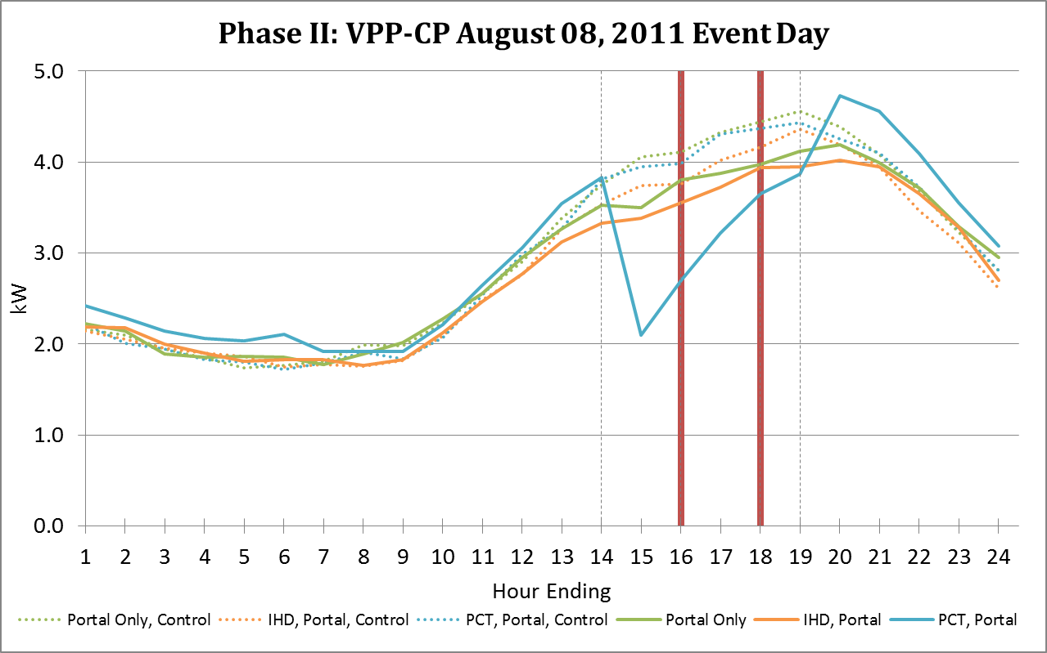
Event Day Savings- Aug 8 Event

Slide 35
Phase I, 2011: Non-Event Demand
 | Average On-Peak Demand |  |  | Demand at Time of Maximum Reduction
 | Baseline | Reduction | % Reduction | Baseline | Reduction | % Reduction
TOU-CP Weekend Non-Event
Portal Only | 3.83 | 0.25 | 6.43% | 3.97 | 0.27 | 6.68%
IHD, Portal | 3.83 | 0.50 | 13.17% | 3.97 | 0.52 | 13.20%
PCT, Portal | 3.71 | 0.13 | 3.39% | 3.46 | 0.16 | 4.76%
All 3 | 3.83 | 0.25 | 6.55% | 3.77 | 0.27 | 7.23%
TOU-CP Weekday Non-Event
Portal Only | 3.46 | 0.50 | 14.32% | 3.32 | 0.53 | 16.00%
IHD, Portal | 3.46 | 0.70 | 20.28% | 3.32 | 0.73 | 21.93%
PCT, Portal | 3.36 | 0.88 | 26.10% | 2.97 | 1.34 | 45.29%
All 3 | 3.46 | 0.95 | 27.48% | 3.08 | 1.31 | 42.69%
VPP-CP Low Weekend
Portal Only | 3.83 | 0.26 | 6.84% | 3.77 | 0.29 | 7.64%
IHD, Portal | 3.83 | 0.36 | 9.33% | 3.77 | 0.38 | 10.15%
PCT, Portal | 3.71 | -0.07 | -1.90% | 3.46 | -0.04 | -1.20%
All 3 | 3.83 | 0.38 | 9.84% | 3.93 | 0.38 | 9.78%
VPP-CP Low Weekday
Portal Only | 2.41 | 0.22 | 8.97% | 2.67 | 0.23 | 8.80%
IHD, Portal | 2.41 | 0.25 | 10.20% | 2.25 | 0.27 | 11.83%
PCT, Portal | 2.30 | 0.03 | 1.43% | 1.92 | 0.10 | 5.46%
All 3 | 2.41 | 0.24 | 9.97% | 2.25 | 0.28 | 12.33%

Slide 36
Phase I, 2011: Non-Event Demand
 | Average On-Peak Demand |  |  | Demand at Time of Maximum Reduction
 | Baseline | Reduction | % Reduction | Baseline | Reduction | % Reduction
VPP-CP Standard Weekday
Portal Only | 3.80 | 0.48 | 12.52% | 3.68 | 0.55 | 15.02%
IHD, Portal | 3.80 | 0.48 | 12.73% | 3.68 | 0.52 | 14.09%
PCT, Portal | 3.69 | 0.65 | 17.69% | 3.32 | 1.18 | 35.58%
All 3 | 3.80 | 0.99 | 26.05% | 3.44 | 1.41 | 41.10%
VPP-CP High Weekday
Portal Only | 4.07 | 0.59 | 14.53% | 3.93 | 0.66 | 16.85%
IHD, Portal | 4.07 | 0.61 | 15.07% | 3.93 | 0.68 | 17.22%
PCT, Portal | 3.96 | 0.81 | 20.46% | 3.53 | 1.44 | 40.76%
All 3 | 4.07 | 1.17 | 28.83% | 3.64 | 1.69 | 46.29%
VPP-CP Critical Weekday
Portal Only | 4.53 | 0.63 | 13.97% | 4.48 | 0.69 | 15.44%
IHD, Portal | 4.53 | 0.67 | 14.83% | 4.48 | 0.80 | 17.84%
PCT, Portal | 4.49 | 1.01 | 22.54% | 4.19 | 1.97 | 47.08%
All 3 | 4.53 | 1.35 | 29.82% | 4.22 | 2.03 | 48.08%

Slide 37
Phase II, 2011: Event Day Demand
 | Average On-Peak Demand |  |  | Demand at Time of Maximum Reduction
 | Baseline | Reduction | % Reduction | Baseline | Reduction | % Reduction
TOU-CP July 15, 2011 Event
Portal Only | 3.92 | 0.29 | 7.39% | 3.89 | 0.53 | 13.67%
IHD, Portal | 3.90 | 0.30 | 7.76% | 3.80 | 0.49 | 12.77%
PCT, Portal | 4.08 | 0.89 | 21.91% | 3.70 | 1.63 | 44.09%
All 3 | 4.17 | 0.74 | 17.77% | 3.83 | 1.31 | 34.19%
VPP-CP July 15, 2011 Event
Portal Only | 4.10 | 0.26 | 6.36% | 4.22 | 0.38 | 8.94%
IHD, Portal | 3.90 | 0.34 | 8.75% | 4.07 | 0.42 | 10.30%
PCT, Portal | 4.17 | 0.96 | 23.01% | 4.06 | 1.75 | 43.09%
All 3 | 4.02 | 0.94 | 23.30% | 3.91 | 1.56 | 39.79%
TOU-CP August 08, 2011 Event
Portal Only | 4.28 | 0.55 | 12.75% | 4.17 | 0.55 | 13.15%
IHD, Portal | 4.01 | 0.41 | 10.12% | 4.07 | 0.41 | 10.19%
PCT, Portal | 4.24 | 1.39 | 32.86% | 4.13 | 1.59 | 38.53%
All 3 | 4.39 | 1.35 | 30.77% | 4.33 | 1.54 | 35.54%
VPP-CP August 08, 2011 Event
Portal Only | 4.38 | 0.45 | 10.38% | 4.44 | 0.46 | 10.43%
IHD, Portal | 4.09 | 0.26 | 6.44% | 4.02 | 0.30 | 7.42%
PCT, Portal | 4.34 | 0.90 | 20.78% | 4.30 | 1.08 | 25.10%
All 3 | 4.15 | 0.87 | 20.88% | 4.12 | 1.06 | 25.79%

Slide 38
Phase II, 2011: Event Day Demand
 | Average On-Peak Demand |  |  | Demand at Time of Maximum Reduction
 | Baseline | Reduction | % Reduction | Baseline | Reduction | % Reduction
TOU-CP August 24, 2011 Event
Portal Only | 4.04 | 0.39 | 9.72% | 4.14 | 0.42 | 10.03%
IHD, Portal | 3.97 | 0.31 | 7.90% | 4.10 | 0.44 | 10.75%
PCT, Portal | 4.21 | 1.36 | 32.34% | 4.06 | 1.52 | 37.49%
All 3 | 4.34 | 1.09 | 25.17% | 4.22 | 1.23 | 29.17%
VPP-CP August 24, 2011 Event
Portal Only | 4.20 | 0.42 | 9.95% | 4.28 | 0.45 | 10.43%
IHD, Portal | 3.96 | 0.23 | 5.79% | 4.05 | 0.28 | 6.88%
PCT, Portal | 4.24 | 1.23 | 29.13% | 4.17 | 1.57 | 37.71%
All 3 | 4.25 | 1.30 | 30.58% | 4.18 | 1.49 | 35.69%

